Slide 1
The Case for Christianity
How We Got the Bible

Slide 2
Faith in Christ Depends upon the Reliability of the Bible
His Role in Prophecy
His Life and Teaching
His Death and Resurrection
His Promises
The Hope He Offers

Slide 3
If It Cannot Be Trusted. . .
Why Follow Its Teaching?
Why Deny Personal Desires?
Why Sacrifice Time and Energy?
Why Compromise Family Bonds?
Why Look to an Unseen Future?

Slide 4
The World Says. . .
“It’s Just an Old Book!”
“It Was Only Written by Men!”
“It’s Full of Contradictions!”
“It’s No Longer Relevant!”
“It Has Been Changed!”

Slide 5
The Case for the Bible
It Is the Product of Direct Action on the Part of God
God Has Worked to Preserve His Word through the Ages
The Text We Read Can Be Trusted and Followed

Slide 6
How We Got the Bible
1. Inspiration
2. Transmission
3. Translation

Slide 7
How We Got the Bible
Inspiration
What does the Bible claim about itself?
1
2
3
2 Timothy 3:16-17
2 Peter 1:19-21
Acts 1:16, 20
2 Samuel 23:2
John 16:13
John 14:26
1 Thessalonians 2:13

Slide 8
How We Got the Bible
1
2
3
René Pache, The Inspiration and Authority of Scripture: found phrases like...
“Thus says the Lord”
“The word of the Lord came to”
3808 Times
(Chicago: Moody Press, 1969, pp. 65, 81)

Slide 9
How We Got the Bible
Inspiration
Accept it or reject it, but the Bible claims to be the product of direct action from God
1
2
3

Slide 10
How We Got the Bible
Transmission
How did this happen?
Two Stages:
Old Testament
New Testament
1
2
3

Slide 11
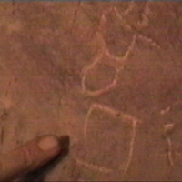
How We Got the Bible
Transmission
Formation of the Old Testament
Giving of Law of Moses (ca. 1400 BC)
Leviticus 27:34; Deuteronomy 29:1
Proto-Sinaitic
Alphabet
Documentary Theories
1
2
3

Slide 12
How We Got the Bible
Transmission
Formation of the Old Testament
Giving of Law of Moses (ca. 1400 BC)
Recovery of the Book of Law under Josiah (ca. 621 BC)
2 Kings 22:8
Began reform and return to the law
1
2
3

Slide 13
How We Got the Bible
Transmission
Formation of the Old Testament
Giving of Law of Moses (ca. 1400 BC)
Recovery of the Book of Law under Josiah (ca. 621 BC)
Return from Exile and Reforms of Ezra (ca. 400 BC)
Nehemiah 8:1-8
1
2
3

Slide 14
“The Great Assembly” (or “Great Synagogue”)
Term used by the Jews for the group who restored the Law with Ezra.
“Moses received the Torah on Sinai, and handed it down to Joshua; Joshua to the elders; the elders to the prophets; and the prophets handed it down to the Men of the Great Assembly”
(Jewish Mishnah, Perke Aboth, 1)
The Babylonian Talmud, says Zechariah and Malachi came “at the end of the prophets”
(Baba Batra, 14b)

Slide 15
How We Got the Bible
Transmission
Formation of the Old Testament
Closed OT Canon (Luke 24:44)
35 Books (Ancient Jews – 22 or 24)
Apocrypha (non-inspired)
1
2
3

Slide 16
How We Got the Bible
Transmission
Formation of New Testament
Translation of Old Testament in Greek
Coming of Jesus of Nazareth
Deuteronomy 18:15; Daniel 9:25
1
2
3

Slide 17
How We Got the Bible
Transmission
Formation of New Testament
Translation of Old Testament in Greek
Coming of Jesus of Nazareth
Promise of the Holy Spirit
John 14:25-26; Mark 13:11; Acts 2; 1 Corinthians 14:37
1
2
3

Slide 18
How We Got the Bible
Transmission
Formation of New Testament
Translation of Old Testament in Greek
Coming of Jesus of Nazareth
Promise of the Holy Spirit
Use of New Testament in Early Church
1
2
3

Slide 19
New Testament Quotations in Early Church Writers
“Indeed, so extensive are these citations that if all other sources of our knowledge of the text of the New Testament were destroyed, they would be sufficient alone for the reconstruction of practically the entire New Testament”
(The Text of the New Testament, Bruce Metzger, p. 86).

Slide 20
How We Got the Bible
Transmission
Formation of New Testament
Translation of Old Testament in Greek
Coming of Jesus of Nazareth
Promise of the Holy Spirit
Use of New Testament in Early Church
Canons and Councils
1
2
3

Slide 21
How We Got the Bible
Translation
How Did It Come into English?
OT (Hebrew); NT (Greek)
1
2
3

Slide 22
Early Translation of the Bible
Slavonic
800s
Gothic
300s
Armenian
400s
Latin
200s
Syriac
200s
Coptic
200s
Ethiopic
500s

Slide 23
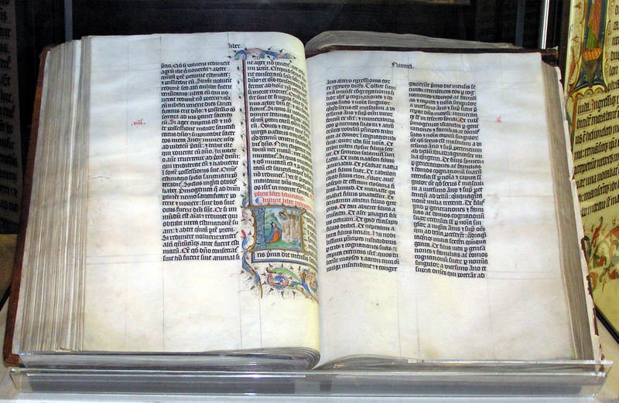
How We Got the Bible
Translation
How Did It Come into English?
Latin Vulgate (405 AD)
Authorized Version of West for 1,000 years
1
2
3

Slide 24
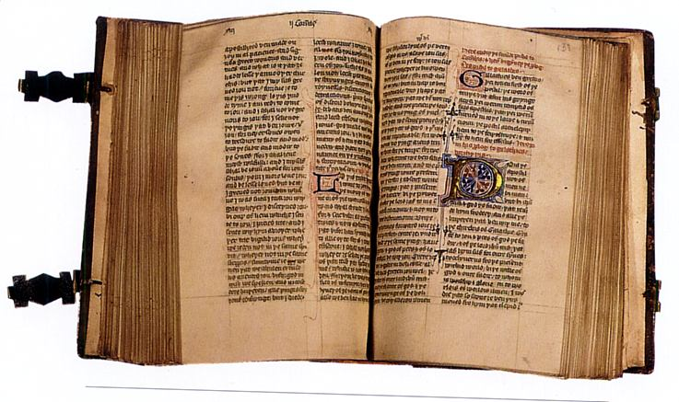
How We Got the Bible
Translation
How Did It Come into English?
First English from Latin (1395)
Wycliffe Bible
1
2
3

Slide 25
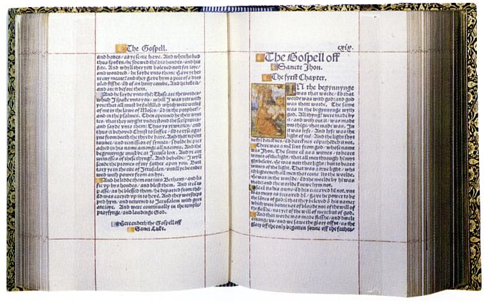
How We Got the Bible
Translation
How Did It Come into English?
First from Greek (1526)
Tyndale Bible
1
2
3

Slide 26
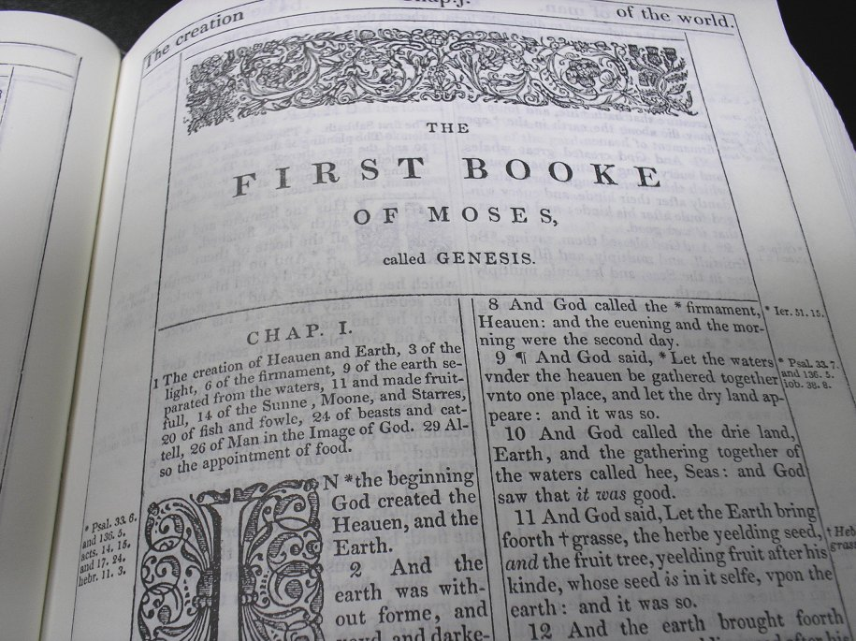
How We Got the Bible
Translation
How Did It Come into English?
54 Translators from Greek and Hebrew (1611)
“Authorized Version” (KJV)
1
2
3

Slide 27
How We Got the Bible
Translation
Why Do Translations Differ?
Style (Formal Equivalence—Paraphrase)
Textual Basis (Role of Discoveries)
1
2
3

Slide 28
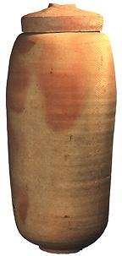
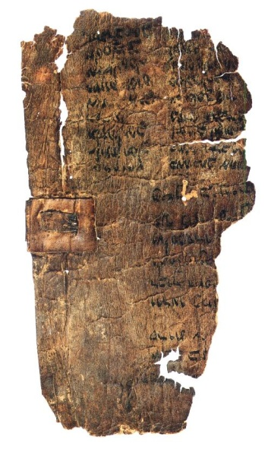
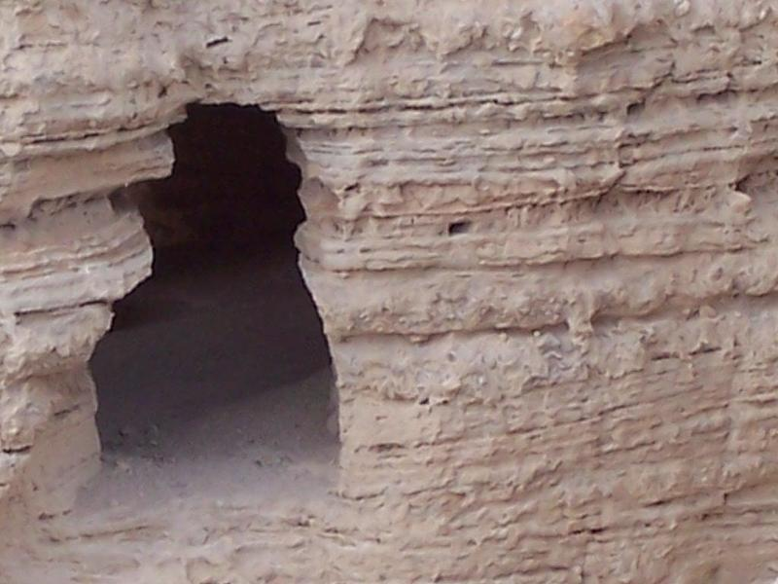
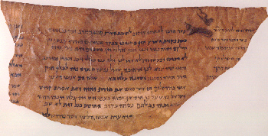
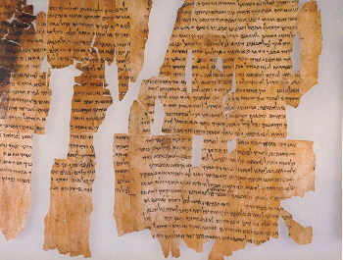
How We Got the Bible
Translation
Old Testament Discoveries
• Dead Sea Scrolls (1946–present)
1
2
3

Slide 29
How We Got the Bible
Translation
Old Testament Discoveries
• Dead Sea Scrolls (1946–present)
100s of biblical and secular texts from 100 BC-70 AD
Provided witness to the reliability of Hebrew Old Testament text
1
2
3

Slide 30
How We Got the Bible
Translation
Old Testament Discoveries
• Silver Scroll Pendant (600 BC)
Text of Numbers 6:24-26
1
2
3

Slide 31
How We Got the Bible
Translation
Old Testament Discoveries
• Hezekiah’s Tunnel Inscriptions (700 BC)
Texts of 2 Kings 18: 1, 4, 8; 20: 13, 20
1
2
3

Slide 32
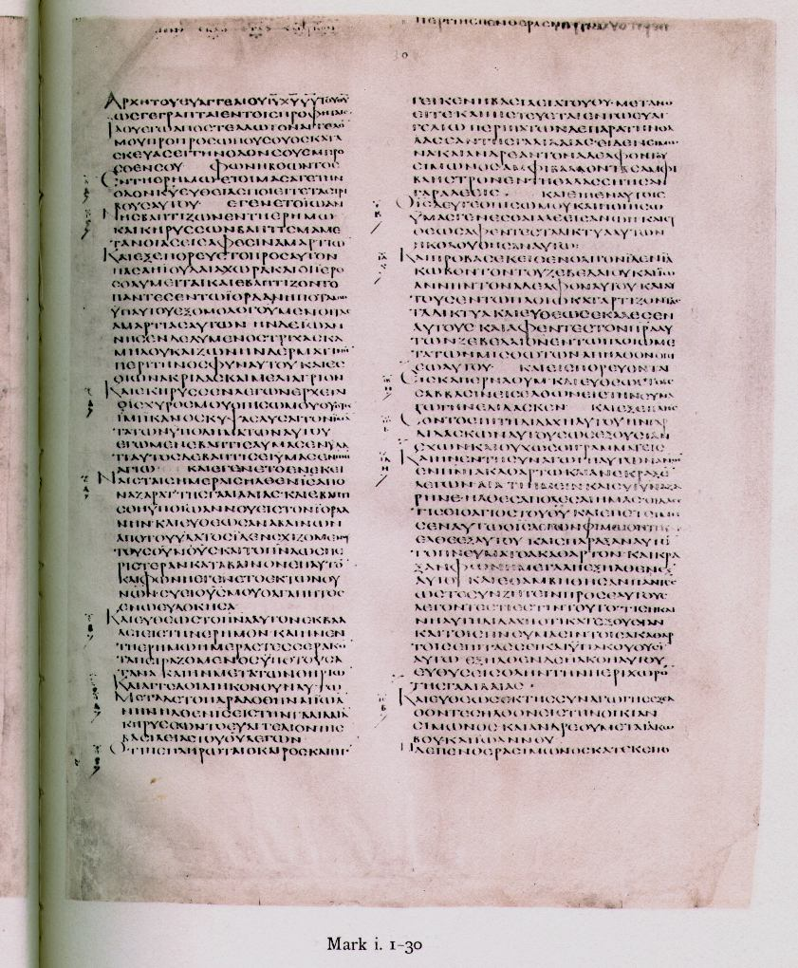
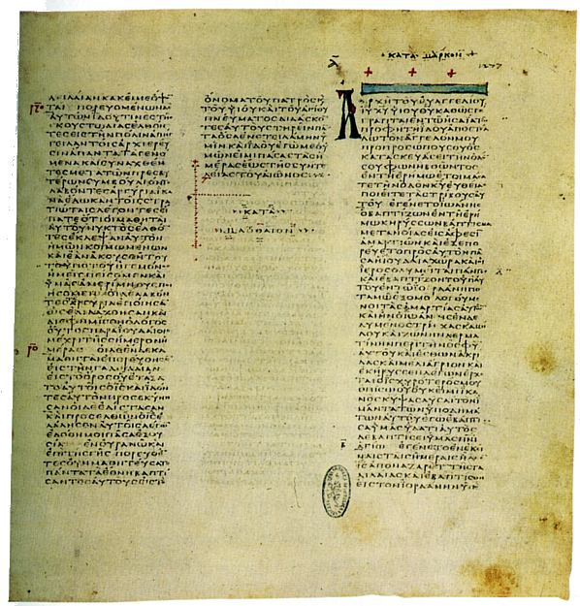
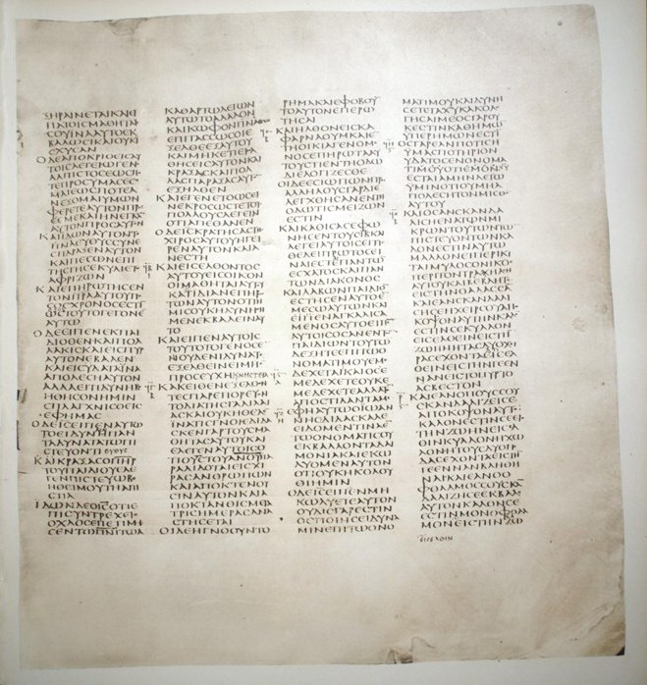
How We Got the Bible
Translation
New Testament Discoveries
• Three Major Majuscule MSS
Vatican, Alexandrian, Sinai
1
2
3

Slide 33
How We Got the Bible
Translation
New Testament Discoveries
• Three Major Majuscule MSS
Provided witness to the reliability of Greek New Testament Text
Only minor differences—mainly spelling
Priority for textual basis?
1
2
3

Slide 34
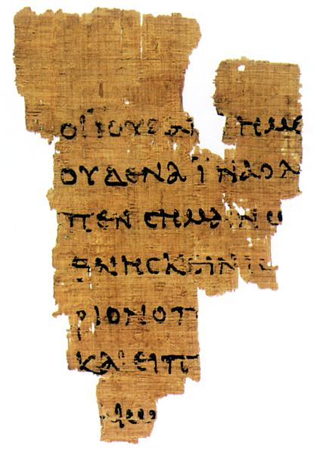
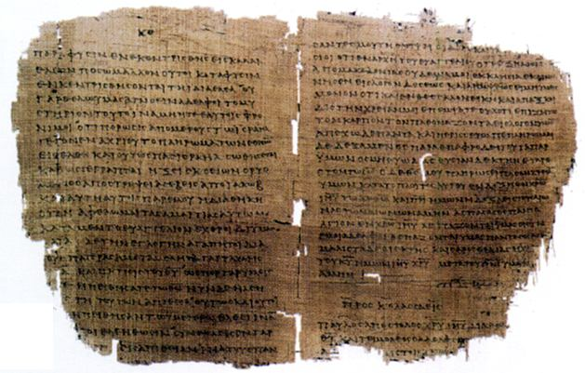
How We Got the Bible
Translation
New Testament Discoveries
• New Testament Papyri
Rylands, Beatty, Magdelan
1
2
3

Slide 35
How We Got the Bible
Translation
New Testament Discoveries
• New Testament Papyri
Provided further witness to the reliability of Greek Text
Some agree with majority of manuscripts
1
2
3

Slide 36
New Testament Reliability
Author | Date Written | Earliest Copy | Approximate Time Span between original & copy | Number of Manuscripts
Plato | 427-347 B.C. | 900 A.D. | 1200 yrs | 7
Herodotus | 480-425 B.C. | 900 A.D. | 1300 yrs | 8
Thucydides | 460-400 B.C. | 900 A.D. | 1300 yrs | 8
Euripides | 480-406 B.C. | 1100 A.D. | 1300 yrs | 9
Caesar | 100-44 B.C. | 900 A.D. | 1000 | 10
Tacitus | circa 100 A.D. | 1100 A.D. | 1000 yrs | 20
Aristotle | 384-322 B.C. | 1100 A.D. | 1400 | 49
Sophocles | 496-406 B.C. | 1000 A.D. | 1400 yrs | 193
Homer (Iliad) | 900 B.C. | 400 B.C. | 500 yrs | 643
New Testament | A.D. 50-100 A.D. | ca. 150 A.D. | less than 100 years | 5600
Modified from Manuscript evidence for superior New Testament reliability, CHRISTIAN APOLOGETICS & RESEARCH MINISTRY www.carm.org

Slide 37
We Can Trust the Bible
“Heaven and earth will pass away, but My words will by no means pass away.”
(Matt. 24:35)

Slide 38
We Can Trust the Bible
“...All flesh is as grass, and all the glory of man as the flower of the grass. The grass withers, and its flower falls away, but the word of the LORD endures forever...”
(1 Pet. 1:24-25)

Slide 39
We Can Trust the Bible
“He who rejects Me, and does not receive My words, has that which judges him–the word that I have spoken will judge him in the last day.”
(John 12:48)

