Slide 1
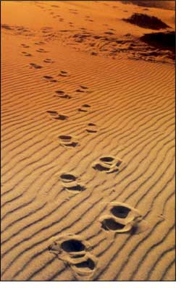
“And whoever does not bear his cross and come after Me cannot be My disciple. For which of you, intending to build a tower, does not sit down first and count the cost, whether he has enough to finish it—lest, after he has laid the foundation, and is not able to finish, all who see it begin to mock him,…”
Luke 14:27-33

Slide 2
“…saying, ‘This man began to build and was not able to finish. Or what king, going to make war against another king, does not sit down first and consider whether he is able with ten thousand to meet him who comes against him with twenty thousand? Or else, while the other is still a great way off…”
Luke 14:27-33

Slide 3
“…he sends a delegation and asks conditions of peace. So likewise, whoever of you does not forsake all that he has cannot be My disciple” (NKJV).
Luke 14:27-33

Slide 4
I. What Do You Have to Lose by Obeying the Gospel?
A. A little time (1 Pet. 4:1-3).
B. A little fun (Heb. 11:25).
C. Some friends (2 Cor. 6:14-17).
D. Some family (Luke 14:26).
E. Some habits (Col. 3:5-11).
F. Some things (1John 2:15).
G. Some choices (Matt.16:24).
The Stakes of the Gospel

Slide 5
II. What Do You Have to Gain by Obeying the Gospel?
A. Time spent well.
B. Meaningful fun (Gal. 5:22).
C. A fellowship of co-believers (1 John 1:1-3).
D. A family of co-workers (1 Cor. 3:9; Eph. 3:15).
E. Healthy habits (1 Cor. 16:15-16).
The Stakes of the Gospel

Slide 6
II. What Do You Have to Gain by Obeying the Gospel?
F. Necessary things (Matt. 6:33).
G. Eternal life with God (Rev. 21:3).
H. Eternal joy, peace and satisfaction (Rev. 21:4).
The Stakes of the Gospel

Slide 7
III. What Do You Have to Lose by Not Obeying the Gospel?
A. All time (Rev. 14:9-11).
B. All joy (Matt. 24:51).
C. All friends and family (Luke 20:34-35).
D. All choice (Luke 16:19-31).
E. All things (Rom. 8:32).
F. God (Matt. 7:23).
G. Your soul (Matt. 16:26-27).
The Stakes of the Gospel

