Slide 1
Love versus Approval and Acceptance
Popular Premise: Because God loves everybody, God accepts everybody. Consequently we ought to love and accept everybody (even the sinful as they continue in their sins).

Slide 2
A Newspaper Article…
“I am proud to be a part of a congregation that is open and affirming to all people. [name of church] desires to create a caring community of equality and grace. That is the kind of church that appeals to me, because it does not erect barriers that prevent anyone from experiencing the amazing love of God.”
The code word for approval now is “affirmation.”

Slide 3
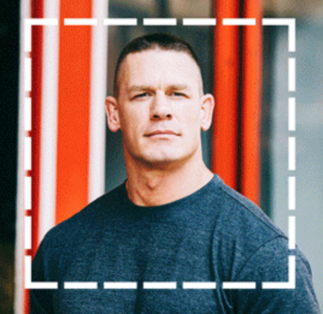
An Ad Campaign…
LOVE HAS NO LABELS
“It should be about love. Love beyond age, disability, sexuality, race, religion and any other labels. Because the second any of us judge people based on those labels, we’re not really being patriotic, are we?”
Actor
John Cena

Slide 4
Love vs. Acceptance
God's circle of love!
God’s circle of love is universal (John 3:16).
There is no man, woman, boy or girl whom God does not love, and whom He does not seek to save (2 Peter 3:9).
Yet even in these passages that speak of His love, a clear line is drawn between saved and lost.

Slide 5
Love vs. Acceptance
God's circle of acceptance or approval!
His circle of fellowship and acceptance is drawn tighter than His circle of love.
God's circle of acceptance excludes:
Those who live in immorality (1 Cor. 6:9-10).
Those who do not know him and do not obey the gospel (2 Thess.1:6-9).
God does not accept His children if they turn from the light to darkness. (1 John 1:5-6).
“… there are few who find it” (Matt. 7:13-14).

Slide 6
Love vs. Acceptance
Our circle of love!
We need to love all men just as God does—our circle of love must be universal.
Not only our friends, and brethren, but even our enemies (Matt. 5:43-46).
We must love those whom society rejects because of prejudice or feelings of social superiority.

Slide 7
Love vs. Acceptance
Our circle of acceptance and fellowship!
Though we love all men we must avoid the appearance of approving, condoning, or accepting conduct contrary to God's will (Eph. 5:11).
Some will call us unloving, judgmental, narrow-minded, or bigoted when we do this.
Our circle cannot be any larger or smaller than God’s!

Slide 8
Love vs. Acceptance
Our circle of acceptance and fellowship!
We need to be careful not be exclusive, or have an attitude of self-righteousness!
It should never give us any pleasure to speak of the sin of others or to refuse those who will not live as they should.
Instead we should feel the deepest grief at their loss (Rom. 9:1-3; 10:1).
And like Paul, and God we should reach out to them with a love that shows them the way into God's circle of fellowship.

