Slide 1
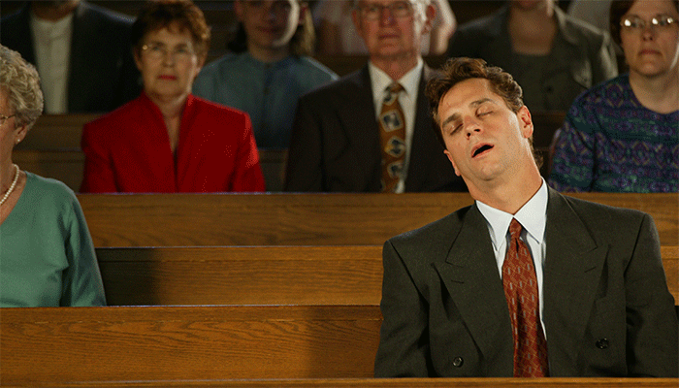
Health Issues
Work Schedule
Sick Child

Slide 2
Bored
Don’t Care
Love the World

Slide 3
I am your child
• I thought you said this was important?
• Is this how you want me to think about church?
• Last night you didn’t sleep during the game.
Eph. 6:4; Deut. 6:6-7; Prov. 22:6

Slide 4
I am your spouse
• I sometimes want to stay home—should we?
• You provide physically—what about spiritually?
• Aren’t you supposed to help me go to heaven?
1 Pet. 3:1-7; Eph. 5:22-33

Slide 5
I am your fellow-Christian
• I am struggling to stay faithful—
why should I care if you don’t?
• We are trying to help you grow spiritually—
How can we do this if you’re asleep?
Heb. 10:24-25; Eph. 4:11-16

Slide 6
I am your preacher
• I am trying to offer you what I think will help.
• I am trying to make it interesting and encouraging.
• I feel like a failure when I see you sleeping.
2 Tim. 4:2-5; 2:15-16

Slide 7
I am your God
• I gave you all things—can’t you give Me time?
• I know your heart—am I so unimportant to you?
• Will you still be sleeping when Jesus returns?
Psa. 139:1-4; Rom. 13:11-14; Eph. 5:14

