Slide 1
Jeremiah 24:1-10
The LORD showed me, and there were two baskets of figs set before the temple of the LORD, after Nebuchadnezzar king of Babylon had carried away captive Jeconiah the son of Jehoiakim, king of Judah, and the princes of Judah with the craftsmen and smiths, from Jerusalem, and had brought them to Babylon. One basket had very good figs, like the figs that are first ripe; and the other basket had very bad figs which could not be eaten, they were so bad. Then the LORD said to me, “What do you see, Jeremiah?” And I said, “Figs, the good figs, very good; and the bad, very bad, which cannot be eaten, they are so bad….”

Slide 2
Jeremiah 24:1-10
… Again the word of the LORD came to me, saying, “Thus says the LORD, the God of Israel: Like these good figs, so will I acknowledge those who are carried away captive from Judah, whom I have sent out of this place for their own good, into the land of the Chaldeans.. For I will set My eyes on them for good, and I will bring them back to this land; I will build them and not pull them down, and I will plant them and not pluck them up. Then I will give them a heart to know Me, that I am the LORD; and they shall be My people, and I will be their God, for they shall return to Me with their whole heart….”

Slide 3
Jeremiah 24:1-10
“…And as the bad figs which cannot be eaten, they are so bad—surely thus says the LORD—so will I give up Zedekiah the king of Judah, his princes, the residue of Jerusalem who remain in this land, and those who dwell in the land of Egypt. I will deliver them to trouble into all the kingdoms of the earth, for their harm, to be a reproach and a byword, a taunt and a curse, in all places where I shall drive them. And I will send the sword, the famine, and the pestilence among them, till they are consumed from the land that I gave to them and their fathers” (NKJV).

Slide 4
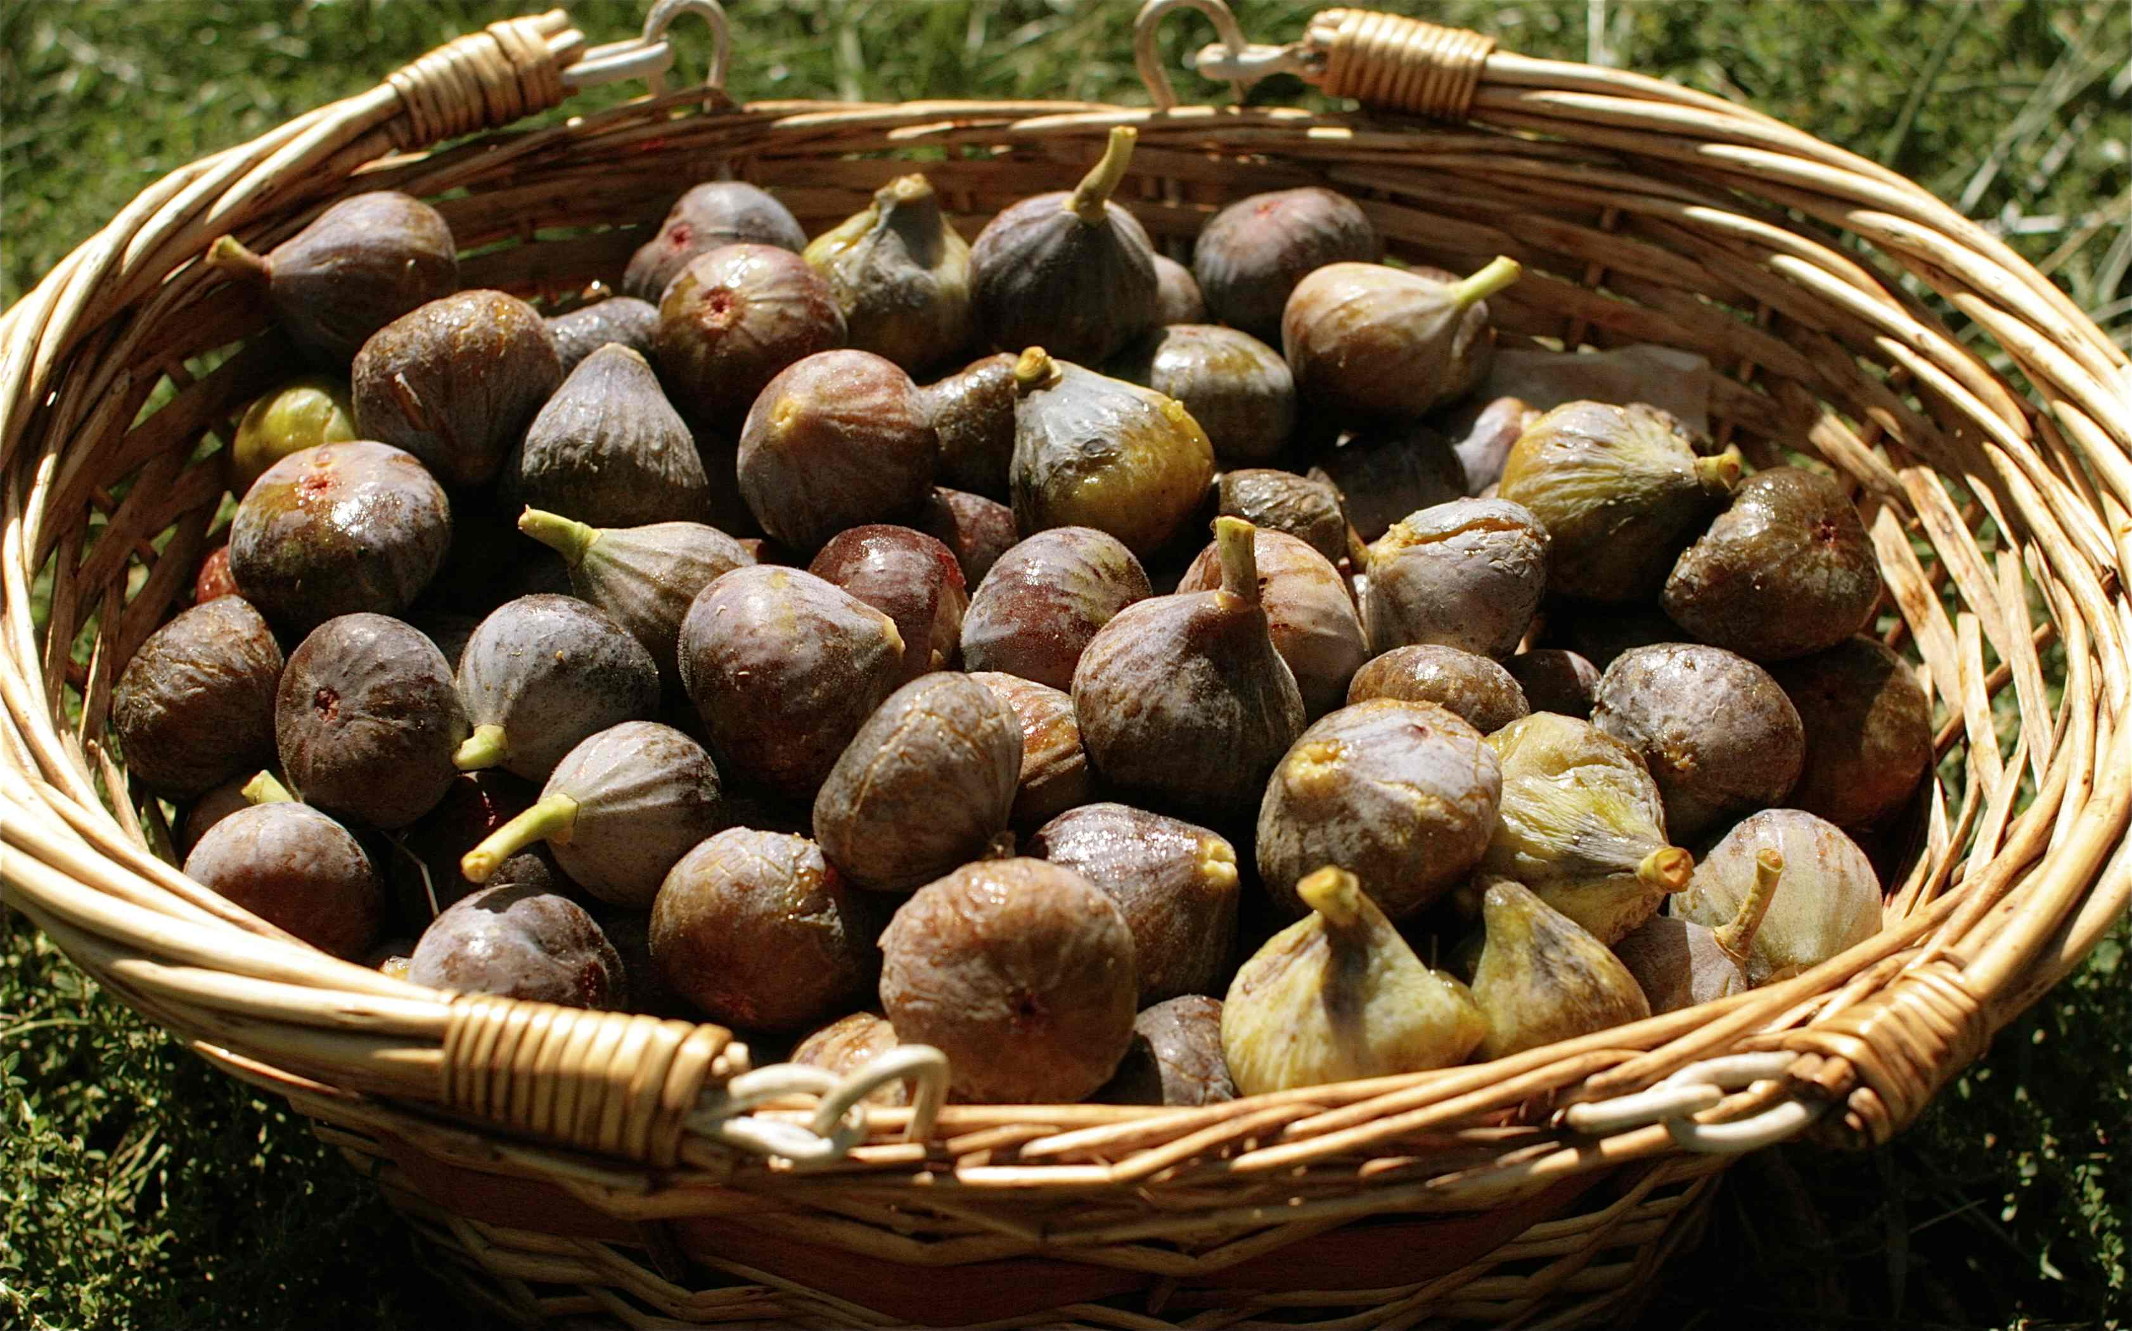
A Basket of Figs
I. The Good Figs were “those who are carried away captive from Judah.”
A. This was allowed “for their good” (5).
• Do you think they felt that this was “for their good?” (cf. Ezek. 18:1-2).
• They felt that they were being mistreated.
B. God said “I will set My eyes on them for good” (6a).

Slide 5
A Basket of Figs
I. The Good Figs were “those who are carried away captive from Judah.”
C. He was looking to their future.
• “I will bring them back to this land” (6b).
• “I will build them and not pull them down, and I will plant them and not pluck them up” (6c).

Slide 6
A Basket of Figs
I. The Good Figs were “those who are carried away captive from Judah.”
C. He was looking to their future.
• ‘Then I will give them a heart to know Me, that I am the LORD” (7a).
• “They shall be My people, and I will be their God, for they shall return to Me with their whole heart” (7b).

Slide 7
A Basket of Figs
II. Christians have been promised some similar things.
A. We are allowed to suffer hardship (Matt. 13:20-21; John 16:33; 2 Tim. 3:12).
• But these things can bring good (Rom. 5:3-4).
•We may feel mistreated in this.
• But God promises that He is watching over us (Heb. 13:5; Matt. 28:19-20).

Slide 8
A Basket of Figs
II. Christians have been promised some similar things.
B. But God is looking to our future.
• He will bring us to a better land (2 Tim. 4:16-18).
• He builds us up—He doesn’t tear us down (1 Cor. 10:13).
• Hardship can shape our hearts turn us to the Lord (Rom. 8:28-38).

Slide 9
A Basket of Figs
III. Lessons from a Basket of Figs.
A. We should not be too quick to see hardship as mistreatment (2 Cor. 4:16-18).
B. Things are not always as they seem.
C. Hardship has the potential to shape our hearts and build us up for good.
D. God is always looking to our future (Phil. 3:12-14).

