Slide 1
Many people are frustrated and uncertain about religion

Slide 2
1 Corinthians 14:33
“…God is not the author of confusion but of peace, as in all the churches.”

Slide 3
Some serve God in one way while others teach He is worshiped in another way.

Slide 4
1 Corinthians 1:10
“Now I plead with you, brethren, by the name of our Lord Jesus Christ, that you all speak the same thing, and that there be no divisions among you, but that you be perfectly joined together in the same mind and in the same judgment.”

Slide 5
Is there a way to cut through all of this confusion and discover the truth about what God expects of men and women in this life?
YES!

Slide 6
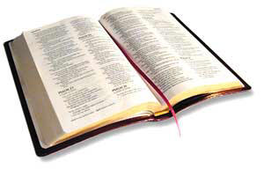
The Answer is Found in God’s Word
Psalm 119:105
“Your word is a lamp to my feet and a light to my path.”

Slide 7
2 Timothy 3:16-17
“All Scripture is given by
inspiration of God, and is profitable for doctrine, for reproof, for correction, for instruction in righteousness, that the man of God may be complete, thoroughly equipped for every good work.”

Slide 8
Ephesians 3:4
“...When you read, you may understand my knowledge in the mystery of Christ.”

Slide 9
“Don’t different people understand the Bible differently?”

Slide 10
2 Peter 1:3
“...His divine power has given to us all things that pertain to life and godliness, through the knowledge of Him who called us by glory and virtue.”

Slide 11
Preconceptions
Preconceived ideas about what God expects.

Slide 12
2 Timothy 4:3
“For the time will come when they will not endure sound doctrine, but according to their own desires, because they have itching ears, they will heap up for themselves teachers.”

Slide 13
Prejudice
A predetermined inclination in a certain direction.

Slide 14
2 Peter 3:2
“Knowing this first: that scoffers will come in the last days, walking according to their own lusts.”

Slide 15
Religious Traditions
Ideas taught by religious groups that are not found in the Bible.

Slide 16
Matthew 15:9
“And in vain they worship Me, teaching as doctrines the commandments of men.”

Slide 17
Family Background
A way our family has always believed about certain matters.

Slide 18
1 Peter 1:18-19
“...You were not redeemed with corruptible things, like silver or gold, from your aimless conduct received by tradition from your fathers, but with the precious blood of Christ, as of a lamb without blemish and without spot.”

Slide 19
“How can we avoid these obstacles and escape religious confusion?”

Slide 20
1. Commit yourself to follow God’s word whatever the cost.

Slide 21
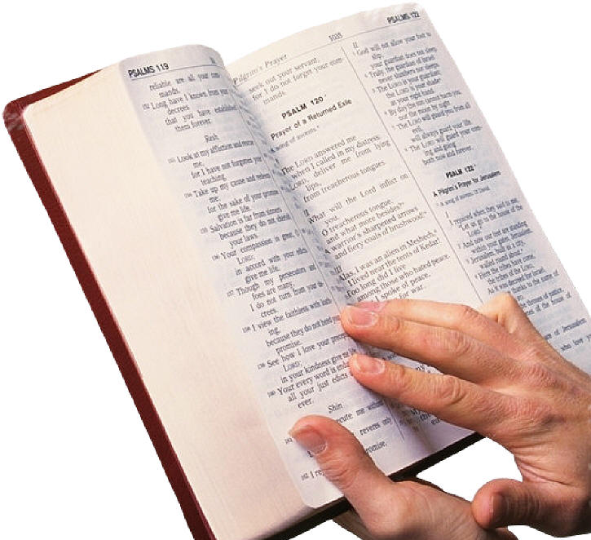
Matthew 10:37
“He who loves father or mother more than Me is not worthy of Me. And he who loves son or daughter more than Me is not worthy of Me.”

Slide 22
2. Test any idea you may hear or think up yourself by the standard of Scripture to see
if it is truly
God’s will.

Slide 23
1 Thessalonians 5:21
“Test all things; hold fast what is good.”

Slide 24
3. Be willing to reject anything that you cannot prove from
Scripture to be
the truth.

Slide 25
Revelation 22:18
“For I testify to everyone who hears the words of the prophecy of this book: If anyone adds to these things, God will add to him the plagues that are written in this book.”

Slide 26
4. Be willing to follow everything that you find in Scripture to
the very best of
your ability.

Slide 27
John 8:31
“Then Jesus said to those Jews who believed Him, ‘If you abide in My word, you are My dis-ciples indeed.’”

