Slide 1
Answering
Don K. Preston
February 2022

Slide 2
Kyle Pope
Olsen Park church of Christ
Amarillo, Texas
www.olsenpark.com

Slide 3
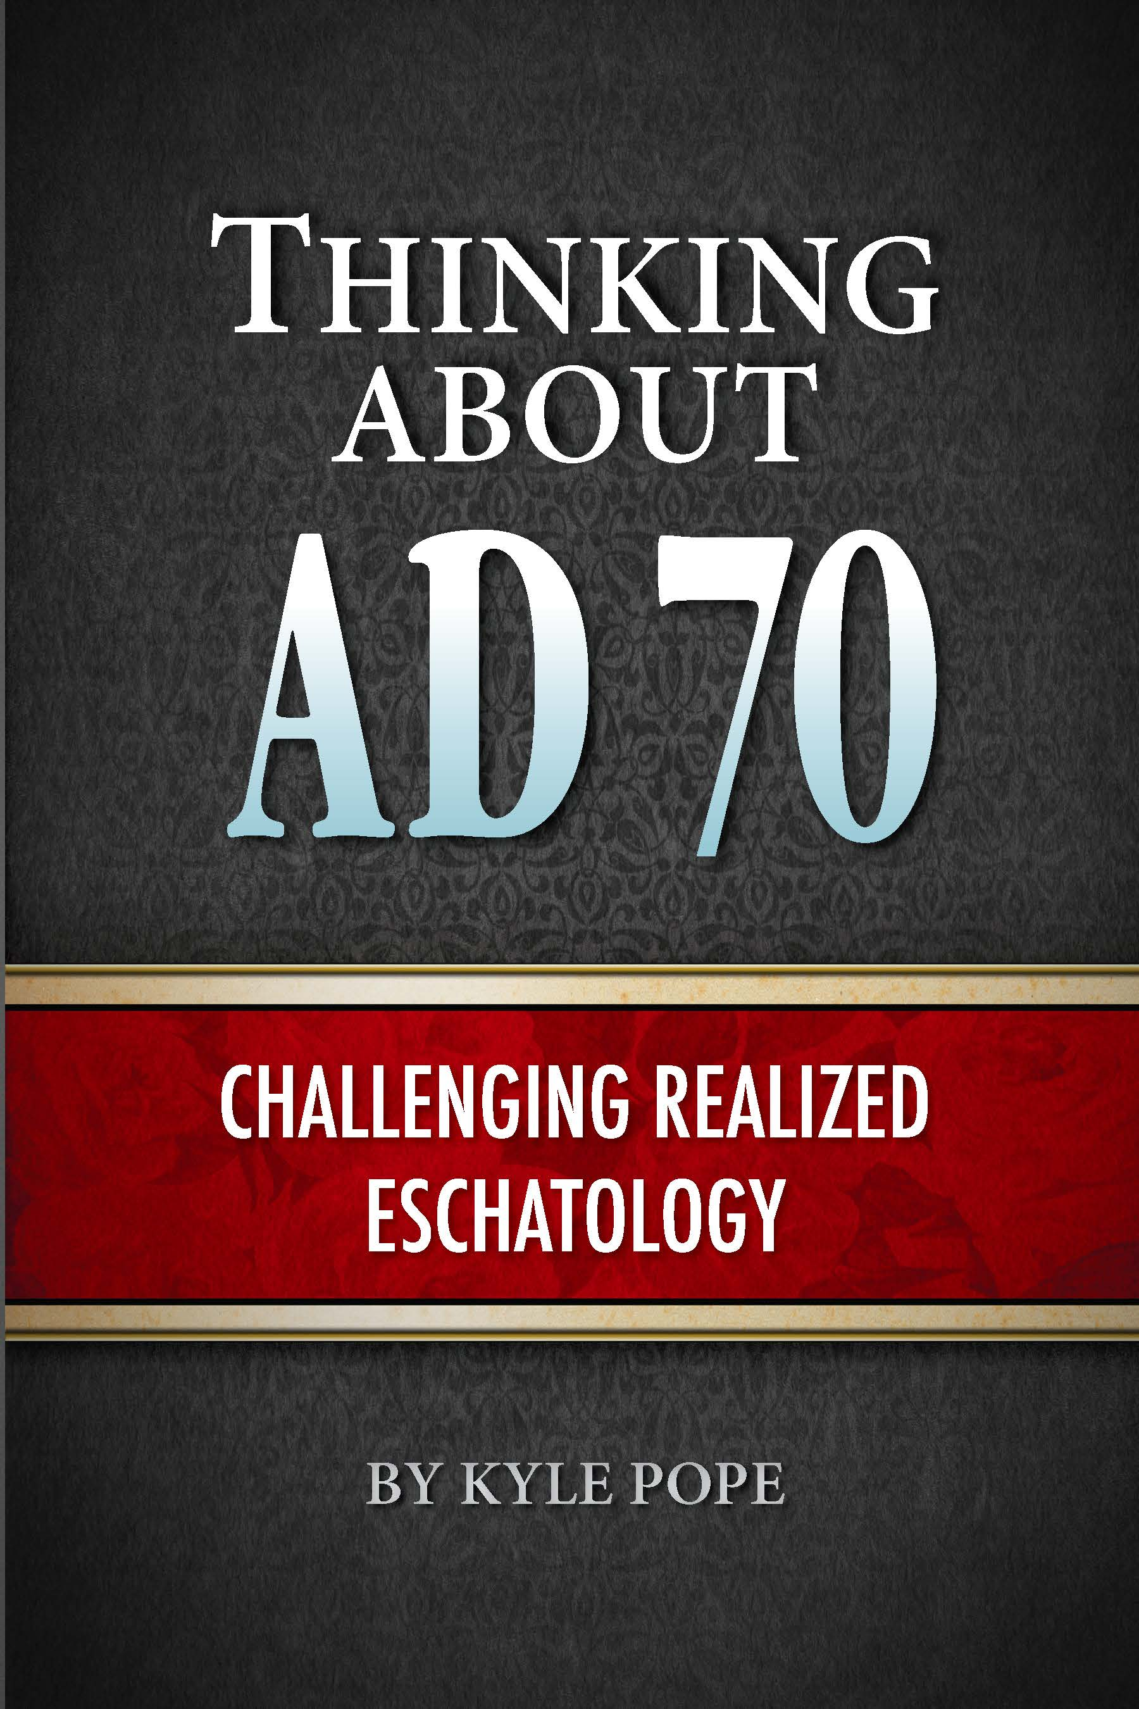
Thinking about AD 70: Challenging Realized Eschatology (Athens, AL: Truth Publications, Inc., 2019)

Slide 4
Realized Eschatology
Full-Preterism
The AD 70 Doctrine

Slide 5
Drawn from studies I had done with some struggling with these issues.

Slide 6
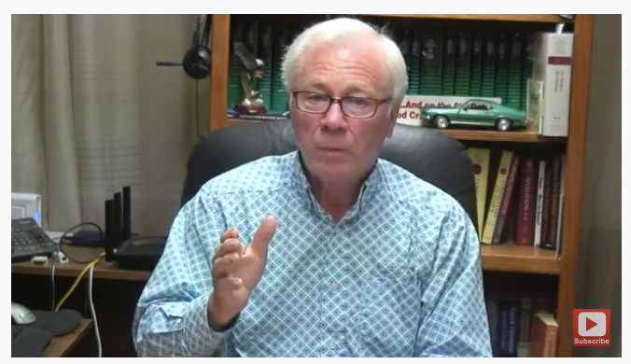
Don K. Preston
May 28-November 19, 2021
20 Video Reviews

Slide 7
YouTube: MrDonPreston, Playlist: “Responding to Kyle Pope” https://www.youtube.com/playlist?list =PLhTk2RamIg8ttUee6fChPJod0vrukdAfB

Slide 8
21 Videos
Two are called “Video Number Ten”

Slide 9
Answering Don. K. Preston
This Video: Website (www.olsenpark.com) and Facebook page Olsen Park church of Christ
Written Text of Video
Summary Article: Truth Magazine April 2022

Slide 10
Answering Don. K. Preston
I have no interest in pursuing this any further.

Slide 11
Answering Don. K. Preston
What the AD 70 Doctrine Teaches

Slide 12
Answering Don. K. Preston
1. All OT apocalyptic cosmological language was only figurative of significant judgments of God and did not foreshadow any future literal fulfillments.
That demands that all NT texts with similar language must also be interpreted figuratively.

Slide 13
Answering Don. K. Preston
2. All biblical time statements (e.g. shortly, quickly, soon, immediately) must be interpreted hyper-literally with fulfillments coming within the generation to whom they were first addressed.

Slide 14
Answering Don. K. Preston
3. Jesus spiritually came in the destruction of Jerusalem by the Romans in AD 70 and will never return again.
There will be no future universal judgment day—all souls are judged individually when they die.

Slide 15
Answering Don. K. Preston
4. A spiritual resurrection of souls coming out of hades occurred in AD 70 and there will never be a future universal bodily resurrection.

Slide 16
Answering Don. K. Preston
5. The physical universe will never be destroyed, and evangelism will continue eternally.

Slide 17
Answering Don. K. Preston
6. For these doctrines to be true the book of Revelation must have been written before AD 70 and the Olivet Discourse can only address the destruction of Jerusalem and not a future final judgment.

Slide 18
Answering Don. K. Preston
The Passing of the Old Law

Slide 19
Answering Don. K. Preston
Preston claimed I teach:
“God was done with Israel at the cross” and
The old law was “no longer applicable” after the cross (first video and repeated)
I never said that!

Slide 20
Answering Don. K. Preston
What I teach:
“Christ is the end of the law for righteousness to everyone who believes” (Rom. 10:4, NKJV).
In establishing His law, Christ, took “away the first that He may establish the second” (Heb. 10:9b).

Slide 21
Answering Don. K. Preston
What I teach:
After the cross, all men are now “under law toward Christ” (1 Cor. 9:21).
This side of the cross the “Israel of God” (Gal. 6:16) has been redefined to include only those of faith in Christ (Rom. 9:6; 2:28-29; Gal. 3:7, 28-29)—Preston never addressed this.

Slide 22
Answering Don. K. Preston
Full-preterists: Because of flawed argument from 1 Corinthians 15:56 they argue. . .
Mosaic Law still binding on Jews until AD 70
Preston: if Mosaic Law was “taken out of the way” (Col. 2:14), nothing prophesied in the Law could still await fulfillment or have any application.
Cites : Rom. 10:19; 11:11; 15:10; Deut. 32:21, 43

Slide 23
Answering Don. K. Preston
This Is a Seriously Flawed Argument!
“The scepter shall not depart from Judah, nor a lawgiver from between his feet, until Shiloh comes; and to Him shall be the obedience of the people” (Gen. 49:10).
Shiloh = Messiah (Jesus)
“The obedience of the people” continues today.

Slide 24
Answering Don. K. Preston
This Is a Seriously Flawed Argument!
Written in Torah, about time before Moses
Part of Patriarchal Law?
Is Patriarchal Law in Force?
Part of Mosaic Law?
Full-preterists: Law until AD 70—Law still in Force?

Slide 25
Answering Don. K. Preston
When One Law Supersedes Another. . .
Becomes what defines sinful and righteous behavior
Does Not Mean Prior Law Loses All Value or Applicability
“For whatever things were written before were written for our learning, that we through the patience and comfort of the Scriptures might have hope” (Rom. 15:4).

Slide 26
Answering Don. K. Preston
The Strength of Sin

Slide 27
Answering Don. K. Preston
Misapplication of 1 Corinthians 15:56
Focus of 1 Corinthians 15: Resurrection
Reality of Christ’s resurrection (15:1-11)
Christ’s resurrection proves the reality of a future universal bodily resurrection (15:12-58)
To answer false charge: “there is no resurrection of the dead” (15:12b)

Slide 28
Answering Don. K. Preston
“So when this corruptible has put on incorruption, and this mortal has put on immortality, then shall be brought to pass the saying that is written: ‘Death is swallowed up in victory.’ ‘O Death, where is your sting? O Hades, where is your victory?’ The sting of death is sin, and the strength of sin is the law. But thanks be to God, who gives us the victory through our Lord Jesus Christ” (1 Cor. 15:54-57, NKJV).

Slide 29
Answering Don. K. Preston
General Full-preterist Claims:
Chapter does not concern physical death.
Spiritual death in every reference to death
“Body” throughout the chapter is the church

Slide 30
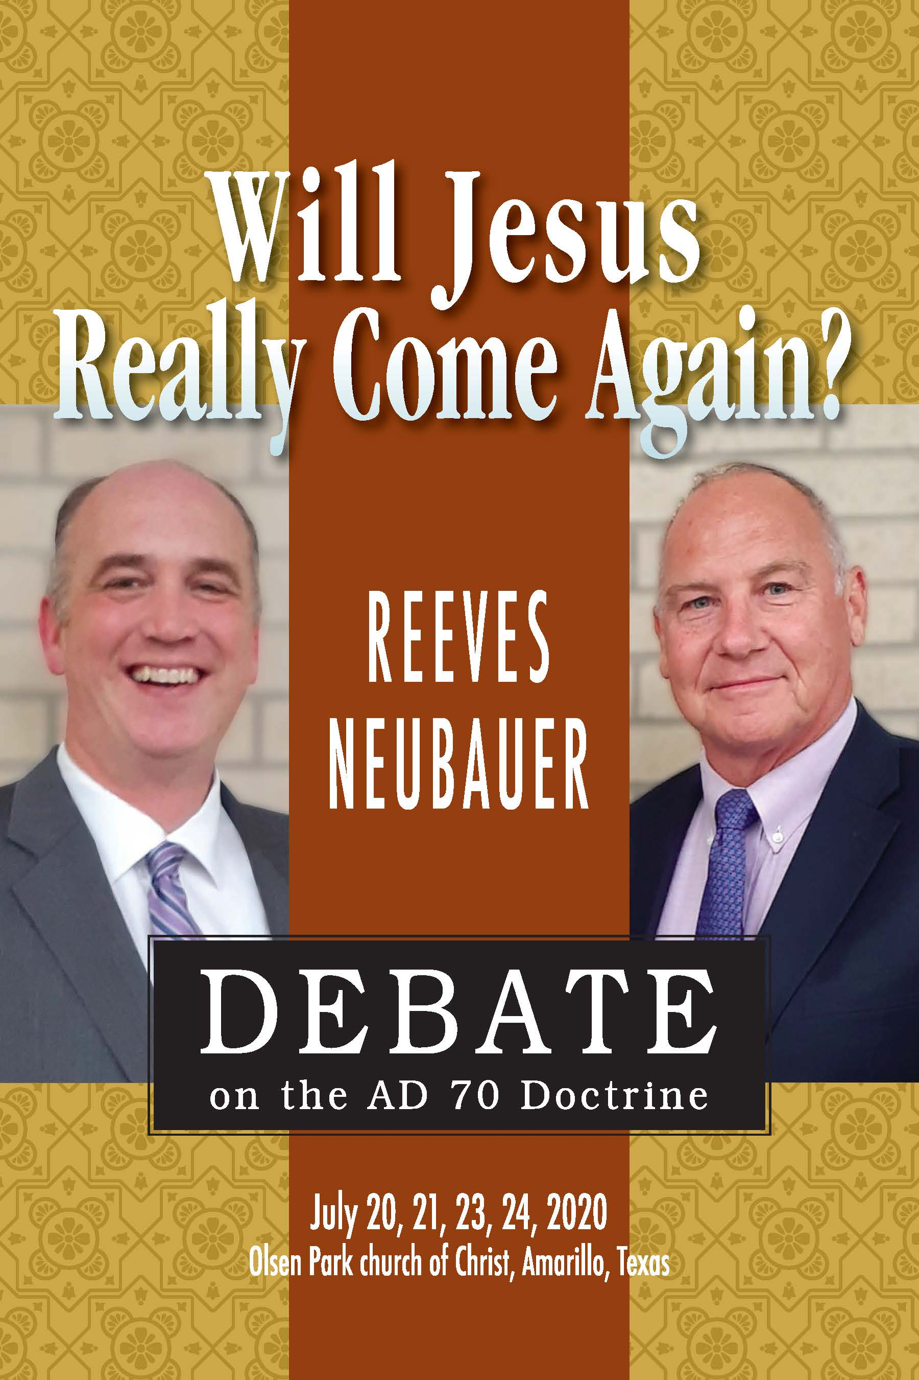
Will Jesus Really Come Again? : Reeves-Neubauer Debate on the AD 70 Doctrine (Athens, AL: Truth Publications, Inc., 2021)

Slide 31
Answering Don. K. Preston
In videos, Preston does not explicitly address whether he holds theses views.
He does understand the resurrection to be a spiritual emptying of hades which he thinks occurred in AD 70.
He does not believe there will be a future resurrection or a future universal judgment.

Slide 32
Answering Don. K. Preston
If that is true:
Death has already been “swallowed up.”
Christians have already “put on incorruption” and “immortality.”

Slide 33
Answering Don. K. Preston
Is that true for Christians today?
Physically human beings still die.
Is spiritual death “swallowed up”?
All around us are souls lost in sin.
They are spiritually dead.

Slide 34
Answering Don. K. Preston
Is that true for Christians today?
Even Christians, having “escaped the pollutions of the world” through obedience to the gospel can become “again entangled in them and overcome” (2 Pet. 2:10).
Spiritual death has not been “swallowed up”?

Slide 35
Answering Don. K. Preston
Preston’s Choices:
1. Accept universalism and say that all living souls are saved—a choice that some Full-preterists have already made.

Slide 36
Answering Don. K. Preston
Preston’s Choices:
2. Accept “once-saved always saved”—a tenet of the false doctrine of Calvinism.

Slide 37
Answering Don. K. Preston
Preston’s Choices:
3. Minimize the force of “swallowed up” or “destroyed” (15:26) so it doesn’t really mean what it says.
He accused me of doing that with time statements. His doctrine does it in many areas.

Slide 38
Answering Don. K. Preston
Preston has not yet accepted universalism:
Argues evangelism will continue forever
That contradicts the view that “death” (i.e. spiritual death) has already been “swallowed up.”

Slide 39
Answering Don. K. Preston
Jesus came “to seek and to save that which was lost” (Luke 19:10).
The lost are separated from God—spiritually dead.
Gospel is “power of God unto salvation” (Rom. 1:16).
If spiritual death has already been “swallowed up” no more souls are spiritually dead—there would be no more need for evangelism.

Slide 40
Answering Don. K. Preston
This is a conflict within his theology that he cannot resolve without abandoning his erroneous beliefs or adopting even more false concepts.

Slide 41
Answering Don. K. Preston
Faulty assumptions in 1 Cor. 15:56, lead Full-preterists to argue Mosaic Law continued for Jews until AD 70.
If so, Paul, Peter, and other apostles lived in sin!
Paul told Peter, “you, being a Jew live in the manner of Gentiles, and not as a Jew” (Gal. 2:14).
If so, they all sinned in eating unlawful foods! But clearly, that was not the case (cf. Acts 11:9).

Slide 42
Answering Don. K. Preston
Preston: a point from 1 Corinthians 15:56 a few times.
Full-preterist Argument:
If death was conquered in AD 70, and the sting of death is sin, and the strength of sin is “the law,” it must mean “the law” ended in AD 70.
That is not necessarily inferred from the text!

Slide 43
Answering Don. K. Preston
Relies on flawed assumptions:
1. It assumes that “the end” (15:24) is AD 70—an assumption that cannot be proven from the text.

Slide 44
Answering Don. K. Preston
Relies on flawed assumptions:
2. It must minimize the force of putting on “incorruption” and “immortality.”
If this is spiritual corruption and mortality, if Christians have it this side of AD 70, they cannot be lost and cannot sin.

Slide 45
Answering Don. K. Preston
Relies on flawed assumptions:
3. It assumes “the law” = Mosaic Law.
Some Jews, but Paul wrote, “You know that you were Gentiles” (1 Cor. 12:2).
Gentiles were never under the Law of Moses—what would this mean to them?

Slide 46
Answering Don. K. Preston
Relies on flawed assumptions:
4. By this reasoning we would also have to say sin ended in AD 70.
It sure doesn’t seem to me that we live in a world free of sin!

Slide 47
Answering Don. K. Preston
What Is the Force of 1 Cor. 15:56?
Principle of sin’s ability to cause spiritual death.
“Where there is no law there is no transgression” (Rom. 4:15)
Paul praises God “who is giving” (present tense), “us the victory through our Lord Jesus Christ” (15:57, YLT).

Slide 48
Answering Don. K. Preston
What Is the Force of 1 Cor. 15:56?
Paul is talking about the ultimate victory Christ is bringing to Christians that in eternity will allow them to overcome completely the sin-to-death principle for all time.

Slide 49
Answering Don. K. Preston
What Is the Force of 1 Cor. 15:56?
Any sense in which it speaks of the end of “the law” it is speaking of a changed condition in eternity in which the blood of Christ has absolutely overcome this sin-to-death principle.

Slide 50
Answering Don. K. Preston
In the videos, Preston does not answer the problems raised by the many assumptions he makes about this verse.
He throws out a charge common among Full-preterists that seeks to appeal to the emotion of his audience.

Slide 51
Answering Don. K. Preston
“Mr. Pope believes the gospel is the strength of sin!” (videos nine and seventeen)
Wow, that sounds horrible, doesn’t it? We all know “the gospel is the power of God unto salvation” (Rom. 1:16).
How could anyone argue that?

Slide 52
Answering Don. K. Preston
I don’t argue that!
Charge rests in assumption that if Mosaic Law had passed away at the cross the only body of law still be in place would be the gospel, the Law of Christ.
They assert, “the gospel saves, it does not condemn!”
Sounds good but ignores many things.

Slide 53
Answering Don. K. Preston
Jesus said His words will judge the world on the day of judgment (John 12:47-48).
Paul taught that God now commands “all men everywhere to repent” because He will judge them by Christ (Acts 17:30-31).

Slide 54
Answering Don. K. Preston
Told Thessalonians God will condemn those “who do not obey the gospel” (2 Thess. 1:8).
Is it a sin not to obey the gospel? Yes.
Then even Preston must admit the gospel defines at least one sin—disobedience to the gospel.

Slide 55
Answering Don. K. Preston
In fact, the gospel will judge all men because it now defines sin and righteousness in this age.
Does the sin-to-death principle still have force? Yes.
Preston: “churches of Christ do not believe the gospel can overcome the problem of sin and death” (video nine).

Slide 56
Answering Don. K. Preston
That is a skewed accusation!
Posed question he said he has never had a satisfactory answer.
Preston: “Is the Christian absolutely, objectively forgiven of sins?” (video seventeen).
If answered, “yes,” he asks: “then doesn’t that person have resurrection life?”

Slide 57
Answering Don. K. Preston
Preston believes full-forgiveness did not come until AD 70, but:
Paul said, “And you, being dead in your trespasses and the uncircumcision of your flesh, He has made alive together with Him, having forgiven you all trespasses” (Col. 2:13).
But also, “you are saved, if you hold fast that word which I preached to you—unless you believed in vain” (1 Cor. 15:2).
Preston: “Already, but not yet”—Paul: Christians can be lost!

Slide 58
Answering Don. K. Preston
Unless Preston adopts “once saved always saved” we could say:
“The Full-preterist gospel does not overcome the problem of sin and death!”
Unless he adopts “once saved always saved” we could say:
His doctrine does not believe one is “absolutely, objectively forgiven of sins.”

Slide 59
Answering Don. K. Preston
The Reality is. . .
The gospel of Christ (while defining sin and righteousness in this age) also offers the means to ultimately overcome sin.
Mosaic Law did not do that. All salvation under Moses looked ahead to the atoning sacrifice of Christ.

Slide 60
Answering Don. K. Preston
The one who abides in Christ receives that atoning sacrifice and will into eternity when spiritual death at last is “swallowed up” forever.

Slide 61
Answering Don. K. Preston
Illegitimate Totality Transfer

Slide 62
Answering Don. K. Preston
In third video, Preston charged me with a linguistic fallacy—a charge he repeated several times throughout the series of videos.
He was addressing my treatment of how Full-preterists interpret the Song of Moses in Deuteronomy 32.

Slide 63
Answering Don. K. Preston
Why is the Song of Moses important to
Full-preterists?
1. It uses language that is applied by NT writers to people in the first century (e.g. “perverse and crooked generation,” 32:5, etc.).

Slide 64
Answering Don. K. Preston
Why is the Song of Moses important to
Full-preterists?
2. It warns of Israel’s “end” (32:20) or “latter end” (32:29). Proponents of this view argue that this proves the song is a specific prophesy pointing to AD 70 as “the end.”

Slide 65
Answering Don. K. Preston
Why is the Song of Moses important to
Full-preterists?
If that is correct, they then argue that AD 70 must be “the end” referred to in other NT passages (such as 1 Cor. 15:24 mentioned above).

Slide 66
Answering Don. K. Preston
In the book I demonstrate:
1. Deuteronomy 31:19 shows the song was to be used as a general “witness” to Israel throughout its history warning them of the consequences of unfaithfulness.

Slide 67
Answering Don. K. Preston
In the book I demonstrate:
2. It became a common vocabulary applied by many generations throughout their history not only to those of the first century.

Slide 68
Answering Don. K. Preston
In the book I demonstrate:
3. The Hebrew word acharith, used in the preface to the song in Deuteronomy 31:29 translated “latter days,” is the same word rendered “end” (32:20) or “latter end” (32:29) in the song.

Slide 69
Answering Don. K. Preston
In the book I demonstrate:
Surveying its use throughout Scripture, I demonstrate that the conceptual basis of acharith broadly refers to what falls afterward generally and is not so narrow as to only apply to the end of Israel’s identity as a nation.

Slide 70
Answering Don. K. Preston
To dismiss this evidence, Preston charged me with “illegitimate totality transfer.”
I was unfamiliar with that term.
In researching it I think he is actually misapplying its meaning and charging me with the very thing the AD 70 Doctrine is built upon.

Slide 71
Answering Don. K. Preston
Prior to the 1960s, biblical language studies often devoted much attention to the etymology (or the root background) of words in order to properly understand their meaning.
In the 1960s that shifted, and more emphasis began to be placed upon context and historical background as a key to understanding word meaning.

Slide 72
James Barr, The Semantics of Biblical Language (Oxford: Oxford University Press, 1961)

Slide 73
He cautioned about the use of a number of lexical fallacies that can compromise biblical interpretation.

Slide 74
Among these was what Barr identified as the illegitimate totality transfer fallacy (ITTF).

Slide 75
Answering Don. K. Preston
Daniel B. Wallace summarizing Barr’s work, explains that ITTF:
“Assumes that all the uses that occur at a given time apply in any given instance”
“Lexical Fallacies by Linguists” danielbwallace.com (Dec. 2014) https://danielbwallace.com/tag/ diachronic/

Slide 76
Answering Don. K. Preston
Example: English word “spoil”
Spoiled food
A spoiled child
One spoiling for a fight
A city spoiled of its treasure

Slide 77
Answering Don. K. Preston
Example: English word “spoil”
We should not imagine when applied to a child that it means the child’s possessions had been plundered, nor think that one spoiling for a fight brings rotten food into the conflict.

Slide 78
Answering Don. K. Preston
Example: English word “spoil”
While all of these meanings share a common conceptual basis describing the degrading of something, if we applied all meanings to every use of the word it would result in nonsense.

Slide 79
Answering Don. K. Preston
Example: English word “spoil”
The sense intended in each use must be determined by contextual indicators.

Slide 80
Answering Don. K. Preston
Contrary to Preston’s charges:
My surveys of acharith, and stoicheia (“elements”), parousia (“coming”), and eutheōs (“immediately”), do not argue that all meanings apply in every instance.
Quite the contrary!
I argue that context must determine meaning.

Slide 81
Answering Don. K. Preston
Contrary to Preston’s charges:
I do address what the conceptual basis of these words can teach us about their meaning.
In most cases, it shows that the meaning is far broader than the narrow subjective definitions Full-preterists try to impose upon them.

Slide 82
Answering Don. K. Preston
So, although acharith can mean “end,” since its conceptual basis describes what comes afterwards and it is used more generally in 31:29, it precludes us from arbitrarily applying it to AD 70 when the context does not specify that.

Slide 83
Answering Don. K. Preston
Preston appeals several times to the Septuagint (LXX) reading in Deuteronomy 31:29, eschaton tōn hemerōn “(the) last of the days.”
Argues that the different wording in Deuteronomy 32:20 ep’ eschatōn “in the last [days]” (Brenton) and 32:29 ton epionta chronon “the time to come” distinguishes it from the sense used in 31:29.

Slide 84
Answering Don. K. Preston
That doesn’t help his argument.
The wording in 32:20 and 29 in the LXX is even more general than the Hebrew and does not limit the focus of the song to the specific AD 70 “end” he imagines.

Slide 85
Answering Don. K. Preston
Preston should consider how the LXX renders this same phrase in Genesis 49:1.
As Jacob begins his prophecy to his sons of “what will happen to you at the last of the days (eschaton tōn hemerōn)” (NETS).

Slide 86
Answering Don. K. Preston
Like the Song of Moses, Jacob’s prophecies refer to the future of his descendants generally throughout their history, not to AD 70 specifically or exclusively.

Slide 87
Answering Don. K. Preston
In the case of parousia (“coming”), ironically it is Full-preterists (and unfortunately even some partial preterists) that broaden the meaning of the word beyond what can be found in any biblical or extra-biblical sources.

Slide 88
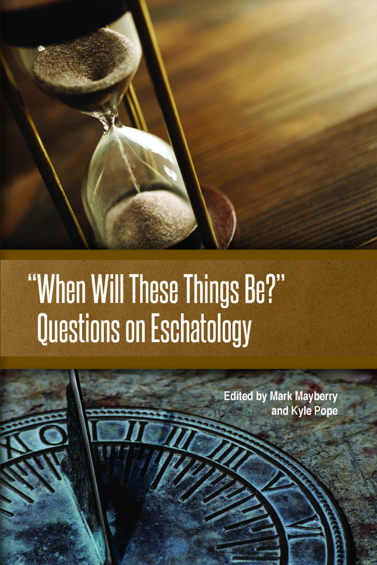
For survey of parousia see “What Is the Focus of the Mount of Olives Discourse?” by Kyle Pope
In “When Will These Things Be?”: Questions on Eschatology, eds. Mark Mayberry and Kyle Pope (Athens, AL: Truth Publications, Inc., 2020, 343-370)

Slide 89
For survey of eutheōs see “Is Matthew 24:34 a Transition Verse?” by Kyle Pope
In “When Will These Things Be?”: Questions on Eschatology (Study Guide), by Kyle Pope (Athens, AL: Truth Publications, Inc., 2021, 253-263)

Slide 90
Answering Don. K. Preston
Melting of the Elements

Slide 91
Answering Don. K. Preston
When Preston charges me with ITTF it is an attempt to reject evidence I offer that broadens the conceptual basis of words beyond the narrow, subjective application Full-preterists try to impose upon their use in specific texts.
If acharith doesn’t exclusively mean “the end” then it becomes harder for Preston to argue that it means AD 70.

Slide 92
Answering Don. K. Preston
In video fourteen, Preston makes the same charge in response to evidence I offer about the use of the Greek word stoicheia (“elements”).
In 2 Peter 3:10 and 12, Preston argues that it does not refer to the elements of the material universe but to the elements of the Jewish system.
He must make this argument or his view that the universe will never end collapses.

Slide 93
Answering Don. K. Preston
In the context. . .
Text begins with a reference to God’s creation of heaven and earth “standing out of water and in the water” (3:5)
The world of the flood that perished “with water” (3:6)
The present heavens and earth “reserved for fire” (3:7).

Slide 94
Answering Don. K. Preston
In the context. . .
In each case it is the material universe that is being addressed.
Only three verses later, it is the “elements” of this same material universe that Peter says will be burned up!

Slide 95
Answering Don. K. Preston
In spite of this context, Preston not only argues that it is the elements of the Jewish system but asserts that every use of stoicheia in the NT must be interpreted that way!
I demonstrate in the book that stoicheia is used in a variety of ways in the NT as proven by the context.

Slide 96
Answering Don. K. Preston
Nothing about that makes me guilty of ITTF.
If my argument about acharith is ITTF, what is Preston’s argument about stoicheia?

Slide 97
Answering Don. K. Preston
Full-preterism depends upon method of interpretation that transfers the meaning of words and phrases from remotely different contexts and applies them equally in all cases.
That is far closer to ITTF than any of my arguments.

Slide 98
Answering Don. K. Preston
Method More Than Mercy

Slide 99
Answering Don. K. Preston
In video twelve, Preston more on 2 Peter 3
Claims I argue the terms “heaven and earth” cannot be used figuratively.
Then falsely claims I switch from treating heaven and earth literally in the first part of the chapter to treating it figuratively later in the chapter.

Slide 100
Answering Don. K. Preston
That is not true! Please read more closely.
He may have had some opponents who argued that about the “new heavens and a new earth in which righteousness dwells” (2 Pet. 3:12).
I do not.

Slide 101
Answering Don. K. Preston
Chapter begins by speaking literally of what God created (3:5), destroyed during the flood (3:6), and will destroy with fire (3:7, 10, 12).
like Revelation 21:1-2, he literally promises a new and different eternal home for the righteous.

Slide 102
Answering Don. K. Preston
It is not a rejuvenated version of the current “heaven and earth,” but it is a literal, tangible, and spiritual existence.

Slide 103
Answering Don. K. Preston
Throughout videos, Preston argues Scripture never promises an end of the material universe.
An argument that depends upon his narrow interpretation of apocalyptic language.
In video six appeals to the flood as imagined proof God will never destroy the material universe.

Slide 104
Answering Don. K. Preston
In 2 Peter 3 the Holy Spirit promises that the world that was destroyed by the flood (3:6) is “reserved for fire” (3:7).
In video six, Preston appeals to the Lord’s words after the flood.

Slide 105
Answering Don. K. Preston
“I will never again curse the ground for man’s sake, although the imagination of man’s heart is evil from his youth; nor will I again destroy every living thing as I have done. While the earth remains, seedtime and harvest, cold and heat, winter and summer, and day and night shall not cease” (Gen. 8:21b-22).

Slide 106
Answering Don. K. Preston
Preston addresses this text in response to evidence I offer in the book from Genesis 8:22.
Literally, it reads, “as long as all the days of the earth.”
Necessarily infers the days of the earth are finite in number.

Slide 107
Answering Don. K. Preston
Preston dismisses this and argues that the Lord’s words in 8:21b teach that God will never destroy the material universe.
The text qualities the Lord’s promise with the words “as I have done.”
2 Peter explains, not with “water,” but “reserved for fire.”

Slide 108
Answering Don. K. Preston
Preston argues that would make God “more concerned with method than mercy!”
That is a subjective appeal to emotionalism, not an exegesis of the text.

Slide 109
Answering Don. K. Preston
If 2 Peter is consistently talking about material creation, it is inescapably promising destruction by fire of that same material creation.
Appeals to an emotional response to that reality do not change what it says.

Slide 110
Answering Don. K. Preston
In same video, Preston claimed I ignore Psalm 148.
In verse six, speaking of “heavens of heavens,” and “waters above the heavens” (v. 5), it says God “established them forever and ever.”

Slide 111
Answering Don. K. Preston
I devote three pages to it specifically addressing the force of the Hebrew word ’ōlam “forever” (Thinking about AD 70, 32-34).
I document evidence that ’ōlam describes “something whose vanishing point is concealed.”

Slide 112
Answering Don. K. Preston
Context demonstrates whether it describes things actually unending by nature (God) or that seem unending from man’s perspective.
Preston actually claimed to agree with this evidence but dismissed its force in Psalm 148:6.

Slide 113
Answering Don. K. Preston
“By This the Iniquity of Jacob Will be Covered”

Slide 114
Answering Don. K. Preston
AD 70 Doctrine much like Gnosticism
Proponents become convinced they have discovered a hidden key to knowledge that few have understood.
They take great pride in what they supposedly understand that has eluded the vast majority of lesser minds.

Slide 115
Answering Don. K. Preston
In accepting this—which to them is “falsely called knowledge” (1 Tim. 6:20), they often allow themselves to adopt radically heretical concepts with little hesitation.
Isaiah 27 is a classic example.

Slide 116
Answering Don. K. Preston
Advocates seek out any passage that says anything about Jerusalem, the temple, or siege terminology and apply it to AD 70.
Isaiah 27:9 is a favorite.

Slide 117
Answering Don. K. Preston
“Therefore by this the iniquity of Jacob will be covered; and this is all the fruit of taking away his sin: when he makes all the stones of the altar like chalkstones that are beaten to dust, wooden images and incense altars shall not stand” (Isa. 27:9, NKJV).

Slide 118
Answering Don. K. Preston
Isaiah wrote these things before:
The destruction of Jerusalem and the temple under Nebuchadnezzar in 587 BC
The Babylonian exile that would follow
Evidence within this text points to those events, not to AD 70

Slide 119
Answering Don. K. Preston
The last verse of the chapter promises those “about to perish in the land of Assyria, and they who are outcasts in the land of Egypt” a time when they “shall worship the LORD in the holy mount at Jerusalem” (27:13).
That points to the return from exile.

Slide 120
Answering Don. K. Preston
In Hebrew, the word translated “wooden images” in 27:9 is “Asherim” (NASB), referring to Canaanite deities worshipped by apostate Jews throughout OT history (cf. 2 Chron. 34:3, 4, 7, et al.).
In the context, the most likely interpretation is that it is prophesying the fall of Jerusalem to Babylon and Israel’s return after this exile.

Slide 121
Answering Don. K. Preston
In spite of this, Full-preterists argue that it is talking about AD 70!
Preston actually argues that the words, “by this the iniquity of Jacob will be covered; and this is all the fruit of taking away his sin” mean that atonement for sin was not actually accomplished by Christ’s death on the cross but achieved by the destruction of Jerusalem (video fifteen).

Slide 122
Answering Don. K. Preston
Before the cross sacrifice and punishment were demanded to make atonement.
After the cross, Hebrews said Jesus, “offered one sacrifice for sins forever” (Heb. 10:12).
“There no longer remains a sacrifice for sins” (Heb. 10:26b)

Slide 123
Answering Don. K. Preston
How could Jerusalem’s punishment atone for sins if there was no longer a “sacrifice for sins”?
John wrote that Jesus is “the propitiation for our sins” and those of the “whole world” (1 John 2:2).

Slide 124
Answering Don. K. Preston
Preston tries to equate this with Daniel 9:24-27, —prophecy about AD 70 destruction of temple.
By including the fall of Jerusalem with all the events involved in the coming of the Messiah it speaks of this as a time, “to finish the transgression, to make an end of sins, to make reconciliation for iniquity, to bring in everlasting righteousness” (Dan. 9:24b).

Slide 125
Answering Don. K. Preston
Finishing transgression and ending sin is far different from arguing that atonement after the cross was accomplished by destroying “the city and the sanctuary” (Dan. 9:26b).
Daniel doesn’t say that nor does Isaiah.

Slide 126
Answering Don. K. Preston
I urge Preston to recognize how his flawed assumptions have led him to adopt truly radical heretical views!

Slide 127
Answering Don. K. Preston
Jesus and the Death of Adam

Slide 128
Answering Don. K. Preston
Anotherexample of realized eschatology’s willingness to embrace blatant falsehood is seen in some of Preston’s comments about the death Jesus experienced on our behalf.

Slide 129
Answering Don. K. Preston
In his ninth video, Preston made the claim that churches of Christ teach that we die physically because of sin.
Preston makes much of the fact that he is (or was) a “fifth generation member of the churches of Christ.”

Slide 130
Answering Don. K. Preston
It is unclear if he still considers himself to be associated with churches of Christ or not.
Most of his comments speak quite disparagingly about churches of Christ and what they teach.

Slide 131
Answering Don. K. Preston
Perhaps he has encountered some in the church who would describe physical death in this way.
I do not, nor do brethren with whom I have been associated.

Slide 132
Answering Don. K. Preston
Adam was warned “in the day that you eat of it you shall surely die” (Gen. 2:17. NKJV).
From the moment that he sinned Adam was separated from God.
A process repeated for all of Adam’s descendant when they first sinned against God (cf. Isa. 59:1-2; Ezek. 18:20; Jas. 1:14-15; Eph. 2:1-3).

Slide 133
Answering Don. K. Preston
Physical death did not come to Adam (nor does it come to us) as a direct result of sin, but it did come as a consequence of sin.
While in the garden with access to “the tree of life” they could “eat and live forever” (Gen. 3:22).

Slide 134
Answering Don. K. Preston
When they were cast out of the garden, they and all of their posterity lost access to the “tree of life.”
Physical death comes to all as a consequence of this.

Slide 135
Answering Don. K. Preston
While this distinction is evident in Scripture, Holy Spirit does not specify in every text “this is spiritual death” or “this is physical death.”
Didn’t God understand this could be confusing?
Of course, He “knows all things” (1 John 3:20; cf. Acts 15:18).

Slide 136
Answering Don. K. Preston
This deliberate ambiguity and correlation between spiritual death (that comes directly because of sin) and physical death (that comes as an indirect consequence of sin) allows for the principle of sacrifice and atonement to have meaning.

Slide 137
Answering Don. K. Preston
Why did God declare that “it is the blood that makes atonement for the soul” (Lev. 17:11b)?
Ultimately, because it would set the stage for what God would accomplish through Christ.

Slide 138
Answering Don. K. Preston
Full-preterists try to argue that physical death existed before Adam’s sin—removing any correlation between physical death and spiritual death.
That completely removes any connection between physical sacrifice and spiritual atonement for sin.

Slide 139
Answering Don. K. Preston
In video eighteen, Preston tried to refute my point that Paul’s description of Jesus as “the firstfruits of those who have fallen asleep” (1 Cor. 15:20) shows a correlation between His resurrection and the future resurrection of the righteous.

Slide 140
Answering Don. K. Preston
Preston argued Jesus was not the first to be raised from the dead, quickly dismissing: Jesus was raised never to die again.
He then made the shocking assertion that Jesus was “the first to be raised from the death of Adam.”

Slide 141
Answering Don. K. Preston
Calvinistic Doctrine of Imputation
Argues that Adam’s sin was literally imputed to all his posterity, and so the only way to overcome that was for the righteous deeds of Jesus to be literally imputed to the saved and the sins of the whole world to be literally imputed to Jesus.

Slide 142
Answering Don. K. Preston
Calvinistic Doctrine of Imputation
Many unfamiliar with these issues might say with little thought “Jesus took all our sins upon Himself!”

Slide 143
Answering Don. K. Preston
Calvinistic Doctrine of Imputation
Isaiah: Jesus would “bear their iniquities” (Isa. 53:11)—Paul: God “made Him who knew no sin to be sin for us” (2 Cor. 5:21).
Literally guilty of sin? No!
If so, not: “lamb without blemish and without spot” (1 Pet. 1:10).

Slide 144
Answering Don. K. Preston
“Death of Adam” = Spiritual Death?
Spiritual Death = Separation from God
Was Jesus, God the Son, ever literally separated from God the Father?

Slide 145
Answering Don. K. Preston
If so, then Christ either:
Stopped being God during this separation
Or, there were two Gods for awhile.
Is Preston ready to accept either one of those heretical conclusions?
Let’s hope not!

Slide 146
Answering Don. K. Preston
“I am not alone, because the Father is with Me” (John 16:32b).
“Forsaken” on cross (Matt. 27:46; Mark 15:34); symbolic as sacrificial propitiation for sin.
“The death He died, He died for sin, once for all” (Rom. 6:10).

Slide 147
Answering Don. K. Preston
Jesus died physically as a sinless sacrifice for the sins of all of mankind.
God accepted this as atonement for sin.
Correlation between physical death and spiritual death (from beginning) how blood of Christ could accomplish this atonement for the souls of mankind (cf. Lev. 17:11b).

Slide 148
Answering Don. K. Preston
If Preston is arguing that Jesus died spiritually, he is allowing his flawed eschatological assumptions to lead him to embrace yet another radical false doctrine!
I beg him to consider the error of his ways.

Slide 149
Answering Don. K. Preston
“Since There Was a Nation”

Slide 150
Answering Don. K. Preston
“And many of those who sleep in the dust of the earth shall awake, some to everlasting life, some to shame and everlasting contempt” (Dan. 12:2, NKJV).
This is the most explicit OT prophecy about resurrection and judgment.

Slide 151
Answering Don. K. Preston
When is this text saying it would happen?
In chapter 9 the coming of the Messiah and even the destruction of the temple in AD 70 was prophesied (Dan. 9:24-27).
Chapter 12 concludes a vision that began in chapter 11 about the rise of “the realm of Greece” (Dan. 11:2).

Slide 152
Answering Don. K. Preston
Prophetically describes rise of Alexander the Great and division of his kingdom among his generals after his death.
In great detail how Israel would become caught in the power struggles between the Seleucids in Syria (to the north) and the Ptolemies in Egypt (to the south).

Slide 153
Answering Don. K. Preston
So detailed it has led some liberal scholars to argue it must have been written during the time of those events and then added to the older sections of Daniel.
Reject that conclusion! It is inspired revelation and evidence of Divine foreknowledge.
I’m sure Preston would agree.

Slide 154
Answering Don. K. Preston
Part addresses brutal persecution of Jews under Seleucid king, Antiochus IV (175–164 BC).
Addressed immediately before chapter 12
“And there shall be a time of trouble, such as never was since there was a nation” (Dan. 12:1b).
Would resurrection occur during that persecution? No.

Slide 155
Answering Don. K. Preston
Persecuted promised: “those of understanding shall fall, to refine them, purify them, and make them white, until the time of the end” (Dan. 11:35).
Promises a post-death deliverance (cf. 12:1c) that would come at “the time of the end.”
Daniel is promised he will arise to his inheritance at “the end of the days” (12:13).

Slide 156
Answering Don. K. Preston
Proponents of the AD 70 Doctrine reject this clear and simple evidence from the context and argue that AD 70 is the time of “the end.”
How do they justify this?

Slide 157
Answering Don. K. Preston
1. They must argue for a transition verse.
In video sixteen, Preston accused me of inserting a 2,500-year transition from Daniel 12:1 to verse 2.
That isn’t true—I have no idea when the Lord will return and bring the universal bodily resurrection of all human beings.

Slide 158
Answering Don. K. Preston
1. They must argue for a transition verse.
Point of Daniel is that those who have served God can be assured of a post-death deliverance.
It does not identify when “the time of the end” will be.

Slide 159
Answering Don. K. Preston
1. They must argue for a transition verse.
Full-preterists themselves must insert a transition of two centuries from the time of Antiochus to AD 70 in 11:35 (Daniel Morris) or 11:45 (Don K. Preston).
Documented in book: no grammatical transition.

Slide 160
Answering Don. K. Preston
2. They must impose a narrow and subjective interpretation of Daniel 12:7b.
Daniel’s question: “How long shall the fulfillment of these things be?” (12:6b), he is told, “when the power of the holy people has been completely shattered, all these things shall be finished” (12:7b).

Slide 161
Answering Don. K. Preston
2. They must impose a narrow and subjective interpretation of Daniel 12:7b.
Full-preterists make several assumptions about this statement.

Slide 162
Answering Don. K. Preston
Full-preterist Assumptions about Daniel 12:7b
1. Wicked First-Century Jerusalem = “Holy People” of 12:7b.
In the context, the holy people being addressed are those Jews during the persecution of Antiochus Epiphanes who remained faithful to the “holy covenant” (11:30).

Slide 163
Answering Don. K. Preston
Full-preterist Assumptions about Daniel 12:7b
1. Wicked First-Century Jerusalem = “Holy People” of 12:7b.
Preston dismisses this context.

Slide 164
Answering Don. K. Preston
Full-preterist Assumptions about Daniel 12:7b
2. “All these things” must include the promised resurrection.
Would also have to include the promise that the “wise” will “shine like the stars forever and ever” (12:3). Has that already been accomplished?

Slide 165
Answering Don. K. Preston
Full-preterist Assumptions about Daniel 12:7b
2. “All these things” must include the promised resurrection.
Preston never addressed that.

Slide 166
Answering Don. K. Preston
Full-preterist Assumptions about Daniel 12:7b
2. “All these things” must include the promised resurrection.
I demonstrate in book that phrase “all these things” often is used in Scripture of main content without including every detail.

Slide 167
Answering Don. K. Preston
Full-preterist Assumptions about Daniel 12:7b
2. “All these things” must include the promised resurrection.
Preston dismissed this evidence in video seventeen, charging me yet again with ITTF.

Slide 168
Answering Don. K. Preston
Full-preterist Assumptions about Daniel 12:7b
2. “All these things” must include the promised resurrection.
Further misuses definition of ITTF applying it to a phrase rather than meanings of a word.

Slide 169
Answering Don. K. Preston
Ironically, Preston (and Full-preterists generally) must do the very thing of which he has inaccurately charged me.
“And there shall be a time of trouble, such as never was since there was a nation” (Dan. 12:1b).

Slide 170
Answering Don. K. Preston
Similar to: “For then there will be great tribulation, such as has not been since the beginning of the world until this time, no, nor ever shall be” (Matt. 24:21; cf. Mark 13:19).
Preston argues they both describe AD 70.

Slide 171
Answering Don. K. Preston
Jesus adds, “nor ever shall be.” Preston, mocks that difference.
Additional difference: “since there was a nation” vs. “since the beginning of the world.”
These are not synonymous statements.

Slide 172
Answering Don. K. Preston
Preston also argued the persecution under Antiochus IV Epiphanes was not the worst “since there was a nation,” and was not even as bad as the fall of Jerusalem under Nebuchadnezzar in 587 BC (video sixteen).
Both were horrible times, but I urge him to look closer at the evidence preserved for us.

Slide 173
Answering Don. K. Preston
The Fall of Jerusalem in 587 BC

Slide 174
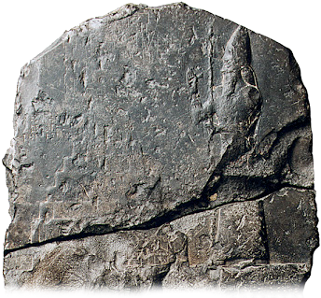
Assaults of Nebuchadnezzar against Jerusalem spanned a decade with 597 BC siege leaving the city intact.
Nebuchadnezzar II

Slide 175
Resulted in the deportation and ultimate death of Jehoiakim (2 Chron. 36:5-8), the deportation of king Jehoiachin, his family, 10-18,000 men who were “fit for war,” with smiths and craftsmen, and treasure from the temple (2 Kings 24:10-16).
Nebuchadnezzar II

Slide 176
Ten years later, in 587 BC, because of the rebellion of Jehoiachin’s uncle, Zedekiah, Jerusalem fell following an eighteen-month siege (2 Kings 25:1-30).
Nebuchadnezzar II

Slide 177
During the siege, those who remained in the city were warned they would die “by the sword, by famine, and by pestilence” but those who defected to the Babylonians would live (Jer. 21:9).
Nebuchadnezzar II

Slide 178
Some fled or defected, but many who stayed within the city suffered from famine, pestilence, and some even practiced cannibalism (Lam. 4:10).
Nebuchadnezzar II

Slide 179
Answering Don. K. Preston
When the walls were breeched the king and his soldiers fled but was captured; his sons were killed before him; blinded and deported.
The temple and the city walls were torn down.

Slide 180
Answering Don. K. Preston
During assault the Babylonians killed “their young men with the sword” including the “young man or virgin,” the “aged or the weak” (2 Chron. 36:17).
“Those who escaped from the sword” were “carried away to Babylon” (2 Chron. 36:20).

Slide 181
Answering Don. K. Preston
During assault the Babylonians killed “their young men with the sword” including the “young man or virgin,” the “aged or the weak” (2 Chron. 36:17).
“Those who escaped from the sword” were “carried away to Babylon” (2 Chron. 36:20).

Slide 182
Answering Don. K. Preston
Horrible time: but surprisingly, the Holy Spirit has not preserved for us numbers regarding the death toll.
Much more is said about those taken captive.
Good figs of Jeremiah’s vision (Jer. 24:1-10)

Slide 183
Answering Don. K. Preston
The Jewish Persecution of Antiochus IV Epiphanes

Slide 184
Answering Don. K. Preston
The persecution prophesied in Daniel 11 and fulfilled in the period between the testaments was of a much different nature.
The temple was not destroyed, nor the walls of Jerusalem torn down, but it was an attempt to exterminate the Jewish religion in a way never seen “since there was a nation” (Dan. 12:1b).

Slide 185
Answering Don. K. Preston
Influence of Greeks led to building of a gymnasium in Jerusalem causing many Jewish men to forsake “the holy covenant” and live as Gentiles.
Some literally made themselves “uncircumcised” in some way to participate naked in these athletic contests (1 Macc. 1:14-15).

Slide 186
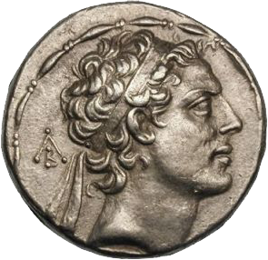
When Antiochus IV took the throne, he was given the surname, Epiphanes “illustrious” but his extreme behavior led some of his own people to change his surname to Epimanes “madman” (Livy, History of Rome 41.19).
Antiochus IV Epiphanes

Slide 187
That was certainly an apt description of him in his treatment of the Jews.
Following a failed effort to conquer Egypt, falsely believing there was a revolt among the Jews, he assaulted Jerusalem.
Antiochus IV Epiphanes

Slide 188
“Then there were massacres of young and old, destruction of women and children, slayings of virgins and infants. Within the total of three days eighty thousand were destroyed, forty thousand in hand-to-hand fighting, and as many were sold into slavery as were killed” (2 Macc. 5:13-14, NETS).
Antiochus IV Epiphanes

Slide 189
This toll of death and deportation is much higher than the biblical record reveals to us during the fall of Jerusalem in 587 BC.
But that was only the beginning!
Antiochus IV Epiphanes

Slide 190
Antiochus himself went into the temple, took away the altar, the lampstand, the table of shewbread, the veil, and the “crown” with the gold and silver vessels, and 1,800 talents (1 Macc. 1:21-24; 2 Macc. 5:15-16, 21).
Antiochus IV Epiphanes

Slide 191
Answering Don. K. Preston
“Therefore there was a great mourning in Israel, in every place where they were; So that the princes and elders mourned, the virgins and young men were made feeble, and the beauty of women was changed. Every bridegroom took up lamentation, and she that sat in the marriage chamber was in heaviness, the land also was moved for the inhabitants thereof, and all the house of Jacob was covered with confusion” (1 Macc. 1:25-28, KJV).

Slide 192
Answering Don. K. Preston
Antiochus commanded one of his officers, Apollonius, with a force of 22,000 to kill those “in their best age” and to sell the young and women (2 Macc. 5:24).
During later incursions, Jerusalem was further plundered and set on fire with houses and walls pulled down “on every side” (1 Macc. 1:31).

Slide 193
Answering Don. K. Preston
The oldest portion of Jerusalem, known as the City of David, was seized and made a citadel for the forces of Antiochus.
In addition to this spoil and slaughter the focus soon shifted to a direct attack on the faith of the Jews.

Slide 194
Answering Don. K. Preston
Daily sacrifice at the temple was stopped for three and a half years (Josephus, Wars of the Jews 1.1).
The temple was dedicated to Jupiter with unclean sacrifices and sexual immorality practiced within its courts (2 Macc. 6:2-5).

Slide 195
Answering Don. K. Preston
Observance of the Sabbath and Jewish festivals was prohibited with those who disobeyed being put to death (2 Macc. 6:6, 9).
Some who hid in caves to observe the Sabbath were found and burned to death all together (2 Macc. 6:11).

Slide 196
Answering Don. K. Preston
Circumcision was forbidden and women who let their children be circumcised were publicly killed with their babies hanging around their necks (2 Macc. 6:10; 1 Macc. 1:60-61).
All Hebrew Scriptures that could be found were burned and anyone found with any portion of the Scriptures was put to death (1 Macc. 1:56-58).

Slide 197
Answering Don. K. Preston
Pagan shrines were erected all throughout Palestine and Jews were compelled to practice pagan worship.
1 and 2 Maccabees record the details of this horrific time.
2 Maccabees 5-7 like a portion of Foxe’s Book of Martyrs; torture and execution of faithful.

Slide 198
Answering Don. K. Preston
Reign of Antiochus IV Epiphanes was brief; Jews eventually delivered from trials by the rise of a Jewish resistance led by Judas Maccabeus.
So traumatic in Jewish history commemorated annually by the Jews (including Jesus) as the “Feast of Dedication” (John 10:22) or Hanukkah.

Slide 199
Answering Don. K. Preston
A level of persecution of Jewish faith unequalled “since there was a nation” (Dan. 12:1b).
Preston casually dismisses severity of this time.
Josephus in Wars of the Jews, primary source for fall of Jerusalem in AD 70, begins with an account of the persecution of Antiochus IV Epiphanes—not with the fall of Jerusalem in 587 BC.

Slide 200
Answering Don. K. Preston
“How Is This Possible?”

Slide 201
Answering Don. K. Preston
In Preston’s last videos he makes an argument to which he has devoted an entire book regarding the nature of the resurrection and Christ’s coming.

Slide 202
Don K. Preston, How Is This Possible? (Ardmore, OK: JaDon Management, Inc., 3rd ed., 2009)

Slide 203
Answering Don. K. Preston
He charges me with inadequately explaining the meaning of 2 Timothy 2:17-18, which records that Hymenaeus and Philetus overthrew the faith of some by claiming “the resurrection is already past.”

Slide 204
Answering Don. K. Preston
He then argues, if the resurrection is to be an “earth burning, time ending event” how would it be possible for anyone to believe or convince others that it had already occurred?

Slide 205
Answering Don. K. Preston
He later made the same argument in an attempt to refute my evidence that the Greek word parousia, translated “coming” in numerous passages in reference to Christ’s return always refers to the actual presence of the one to whom it is applied.

Slide 206
Answering Don. K. Preston
He appealed to 2 Thessalonians 2:1-2, which he first claimed I “conveniently ignored,” then falsely claimed that I have built my views upon the wording of this text in the KJV.
How can I ignore something and yet at the same time build my belief system upon a certain translation of it?

Slide 207
Answering Don. K. Preston
Neither claim is true!
The text refers to the “coming (parousia) of our Lord Jesus Christ” and Paul urges them not to be shaken by those who would argue that “the day of Christ had come” (NKJV).

Slide 208
Answering Don. K. Preston
Preston asks how it would be possible for anyone to think Christ had already come if His coming was to be a “personal, literal, visible, bodily coming of Christ?”

Slide 209
Answering Don. K. Preston
Odd Argumentation
Appeals to what the NT clearly identifies as false doctrine to supposedly demonstrate the nature of sound doctrine.

Slide 210
Answering Don. K. Preston
Like arguing, “if baptism really was immersion, how could anyone ever come to believe that it was sprinkling or pouring?”
People often accept false notions about biblical concepts without scriptural authority.

Slide 211
Answering Don. K. Preston
The nature of false doctrine does not prove anything about sound doctrine.
I urge Preston to consider rather how these false doctrines parallel exactly his own teaching!

Slide 212
Answering Don. K. Preston
Apocalyptic Language

Slide 213
Answering Don. K. Preston
In video ten, Preston addresses an issue I raised in the book about the interpretation of apocalyptic language.
I used a term coined by commentator William Hendrickson to describe what he believes to be the dual application of prophetic apocalyptic language: prophetic foreshortening.

Slide 214
Answering Don. K. Preston
Hendrickson compares it to the way that mountain tops, seen from a distance can appear to be closer than they are (Thinking about AD 70, 35).
With this, Hendrickson is arguing (and I agree) that apocalyptic language can have a dual application: immediate and long term.

Slide 215
Answering Don. K. Preston
Preston mocked this concept, charged that it is not valid in personal experience, and dismissed the very idea.
That does not prove from Scripture that apocalyptic language cannot foreshadow future events.

Slide 216
Answering Don. K. Preston
For realized eschatology to be true all cosmological apocalyptic language must apply only to the event with which it was first associated.
It can have no dual meaning or literal application to any future events.

Slide 217
Answering Don. K. Preston
In a 2006 article (now removed from his website) entitled “What Is Preterism,” Preston explained this.

Slide 218
Answering Don. K. Preston
“The language of the prophets by its very definition is veiled and obscure; it is marked by poetic imagery, license, and exaggeration, and is impressed with hyperbole, metaphors, and symbols. . . . The manner of fulfillment was essentially spiritual, not physical, and that language which on its face appears to describe the dissolution of the chemical elements . . .”

Slide 219
Answering Don. K. Preston
“. . .in a cataclysmic end of time and space must be given a figurative construction and interpretation. This is required, not only because of the confines for fulfillment imposed by statements of time, but by the usus loquendi [manner of speech] of the prophets.”
“What Is Preterism?” Bible-Prophecy.com (Sept. 18, 2006) https://bible-prophecy.com/articles/2006/09/18/what-is-preterism).

Slide 220
Answering Don. K. Preston
Preston says apocalyptic language is “exaggeration.”
Does God exaggerate?
He argues it “must” be given a figurative interpretation.
Why?

Slide 221
Answering Don. K. Preston
First, because of “the confines for fulfillment imposed by statements of time.”
How do we know that the time statements aren’t figurative?
If God uses “exaggeration” in apocalyptic language how do we know He doesn’t do the same with time statements?

Slide 222
Answering Don. K. Preston
Second, he says it must be figurative because this is just the “usus loquendi,” a Latin phrase meaning manner of speech, “of the prophets.”
Let’s break this down and relate it to some things Preston said in the videos.

Slide 223
Answering Don. K. Preston
In video seven Preston asked what hermeneutical principle allows a NT writer to quote OT figurative language and apply it literally?
All would agree that some apocalyptic language with cosmological elements can have an immediate figurative application indicating the importance of the event being described.

Slide 224
Answering Don. K. Preston
Acts 2 fulfilled Joel 2 on the Day of Pentecost but the sun was not literally darkened nor was the moon turned to blood.
But Preston assumes that it only has immediate application and cannot foreshadow any future fulfilment.

Slide 225
Answering Don. K. Preston
Dual applications and fulfilments run throughout Scripture.
Matthew quotes Hosea:“Out of Egypt I called My Son” (Hos. 12:1)—applies it to Jesus in Egypt (Matt. 2:15).
The context of Hosea was talking about Israel as a nation, but it foreshadowed what happened in the life of Christ.

Slide 226
Answering Don. K. Preston
Dual applications and fulfilments run throughout Scripture.
Isaiah’s prophecy “the virgin shall conceive and bear a Son” (Isa. 7:14) had immediate application to when Assyria would take Israel (Isa. 7:17) and a future application to Christ’s birth (Matt. 1:23).

Slide 227
Answering Don. K. Preston
“God is not a man, that He should lie, nor a son of man, that He should repent. Has He said, and will He not do? Or has He spoken, and will He not make it good?” (Num. 23:19).
This has serious ramifications for our discussion.

Slide 228
Answering Don. K. Preston
In arguing that apocalyptic language can have a future literal fulfilment, Preston accuses me of petitio principii (“begging the question”).
He has the burden of proof here!

Slide 229
Answering Don. K. Preston
He must prove:
That God exaggerates.
That God has flexibility in His use of apocalyptic language but is limited by time statements.
That “exaggeration” was just the manner of speech of the prophets

Slide 230
Answering Don. K. Preston
So far, he has failed to prove any of these claims.
He simply asserts what he claims to prove.

Slide 231
Answering Don. K. Preston
If God exaggerates, Preston is asserting that He actually has said things that “He will NOT do” and “He will NOT make good!”
If apocalyptic cosmological language has dual application God is honest.
Immediate figurative fulfilment foreshadows future literal fulfilment.

Slide 232
Answering Don. K. Preston
If it is all an “exaggeration” then God lied!
If so, how can we know that anything He said is not “exaggeration.”
Full-preterism compromises the very honesty of God!.

Slide 233
Answering Don. K. Preston
I would ask, what hermeneutic principle allows us to tie God’s hands when it comes to time statements?

Slide 234
Don K. Preston, Can God Tell Time? (Ardmore, OK: JaDon Management, Inc., 2008)

Slide 235
Answering Don. K. Preston
His argument is that God uses language that is understandable to His audience.
As such, he argues that this limits God’s use of time statements to the narrow subjective time periods Full-preterists imagine.

Slide 236
Answering Don. K. Preston
They don’t use this same argument of understandability when with apocalyptic language.
Holy Spirit said, “with the Lord one day is as a thousand years and a thousand years as a day” (2 Pet. 3:8; cf. Ps. 90:4).
Full-preterists dismiss the force of this.

Slide 237
Answering Don. K. Preston
It is amazing to me how willing Full-preterists are to limit God’s manner of expressing His word and His will in ways we would never impose upon a human author.
We see this not only in their narrow and subjective interpretation of time statements but prophetic language itself.

Slide 238
Answering Don. K. Preston
In video eleven, Preston argues that the biblical principle is that the literal always comes first and then the spiritual.
Really?

Slide 239
Answering Don. K. Preston
Why would he say this?
Because otherwise his theory about apocalyptic language always being figurative and never foreshadowing the literal collapses.

Slide 240
Answering Don. K. Preston
Is his so-called “biblical principle” valid?
Not in Genesis 37:5-10
Joseph dreams that sheaves and the sun, moon, and stars bow down to him.
That was figurative but it was literally fulfilled later when Joseph ruled under Pharaoh in Egypt during the famine.

Slide 241
Answering Don. K. Preston
Is his so-called “biblical principle” valid?
Not in Genesis 41:1-8
Pharaoh dreamed about cows and stalks devouring other cows and other stalks.
That was figurative, but it was literally fulfilled when Egypt faced seven years of famine.

Slide 242
Answering Don. K. Preston
Because man calls something a principle does not limit God’s ability to express things however He chooses and we should not allow it to limit how we interpret His word.

Slide 243
Answering Don. K. Preston
“The Voices of the Prophets”

Slide 244
Answering Don. K. Preston
Let’s go back to this assertion that “exaggeration” is just the manner of speech of the prophets.
I have heard Full-preterists make the assertion that this theorized exaggerated hyperbolic language, with no concept of it ever being literally fulfilled was just “how it would have been understood” by ancient Jews and faithful Christians.

Slide 245
Answering Don. K. Preston
Some, drawing from Paul’s words in Acts 13:27, assert that this Full-preterist interpretation of apocalyptic language is what it means to truly listen to “the voices of the prophets.”
That treats God’s word as if it is some hidden code that can only be discerned by those gifted enough to unravel it!

Slide 246
Answering Don. K. Preston
In video nineteen, Preston took an interesting turn in his attempt to try and prove this assertion about the manner of speech of the prophets.
After devoting most videos to the argument that this prophetic exaggeration was Jewish idiom, he admitted that Jews in the first century believed in literal eschatological fulfilments but those who did so were wrong!

Slide 247
Answering Don. K. Preston
Preston argued that throughout the gospel of John we see those who made physical interpretations when a spiritual meaning was intended:
Eating Christ’s flesh as the “bread of life” (John 6:53-59)
Destroying the temple, when Jesus was speaking of His body (John 2:19-22)

Slide 248
Answering Don. K. Preston
He then asserted that I and those who oppose full-preterism have a “carnal view” of eschatology, claiming “this is the very hermeneutic that put Jesus on the cross!”
That’s a bold statement!

Slide 249
Answering Don. K. Preston
I presume he means the Jews were looking for a Messiah that would reign over a physical kingdom and since that was not what Jesus intended to do, they crucified Him.
Preston is apparently trying to equate that with what I teach.
That is not what I teach!

Slide 250
Answering Don. K. Preston
This betrays what I believe is an underlying problem with which Full-preterists struggle:
An almost Gnostic concept of the physical (as evil) versus the spiritual (as good) with no correlation between the two.

Slide 251
Answering Don. K. Preston
In video eighteen, Preston claimed that I teach you can’t go to heaven without a physical body.
That is not true!
A glorified spiritual body is not a physical body, but neither has a disembodied spirit yet put on a glorified spiritual body.

Slide 252
Answering Don. K. Preston
Certainly, Paul taught “flesh and blood will not inherit the kingdom of God” (1 Cor. 15:50).
In the same chapter Paul spoke of the body that is “sown” as “a natural body” but “it” (not the spirit, but the body) “is raised a spiritual body” (1 Cor. 15:44).

Slide 253
Answering Don. K. Preston
In Preston’s view the “it” is the spirit—but that is not what the text teaches.
Full-preterists muddy this accusing opponents of making it about biology or the physical.
That treats it as if conditions at the resurrection will remain no different than they are at the present.

Slide 254
Answering Don. K. Preston
Just as they fail to recognize the way in which Jesus’s physical death accomplished a spiritual atonement (as we shall see). . .
They also fail to recognize that in eternity the distinctions between the physical and the spiritual will be erased.

Slide 255
Answering Don. K. Preston
Eternal life will not be on a rejuvenated version of earth as it now exists, but it will be a tangible spiritual existence in which the spirits of the righteous are clothed with incorruptible, immortal bodies.
They will not be disembodied spirits floating on the clouds.

Slide 256
Answering Don. K. Preston
“There Is about to Be”

Slide 257
Answering Don. K. Preston
Throughout the videos, with little or no explanation, Preston frequently quotes eschatological passages usually rendered “will be” and puts them “is about to be.”

Slide 258
Answering Don. K. Preston
In video seventeen he quotes Acts 24:15: “I have hope in God, which they themselves also accept, that there will be a resurrection of the dead, both of the just and the unjust” (NKJV) and puts it “there is about to be a resurrection.”

Slide 259
Answering Don. K. Preston
Why does he do that?
Because of a narrow interpretation Full-preterists impose upon the Greek word mellō.

Slide 260
Answering Don. K. Preston
Greek word mellō, defined:
“I. to be destined or likely to, indicating an estimated certainty or strong probability in the present, past, or future; II. to be about to, in purely temporal sense; III. to be always going to do without ever doing: hence, delay, put off; IV. Participle mellōn is used quasi-adjectivally, ho mellōn chronon, the future time; V. might be delayed” (LSJ).

Slide 261
Answering Don. K. Preston
Greek word mellō, defined:
In the NT, it is used 110 times. The KJV translates it shall (25), should (20), would (9), to come (9), will (7), things to come (4), not translated (3), miscellaneously (33).

Slide 262
Answering Don. K. Preston
Greek word mellō, defined:
YLT is one of the few translations that frequently renders it “about to be.”
Preston doesn’t usually use this translation. But in eschatological texts he puts it that way.

Slide 263
Answering Don. K. Preston
I wonder if he would in Acts 26:22-23?
“Therefore, having obtained help from God, to this day I stand, witnessing both to small and great, saying no other things than those which the prophets and Moses said would [mellō] come—that the Christ would suffer, that He would be the first to rise from the dead, and would [mellō] proclaim light to the Jewish people and to the Gentiles” (NKJV).

Slide 264
Answering Don. K. Preston
Full-preterists make much of this text.
They call to attention the fact that Paul says he taught “no other things” than what was said in the “the prophets and Moses.”
Their argument is that one can look to the OT to teach everything in the gospel.

Slide 265
Answering Don. K. Preston
Reminds me of a study I once had with a Messianic Jew who said one can learn everything they need to know to be saved in the first chapters of Genesis.
Really?
I doubt Preston would go that far, but he comes close in some arguments.

Slide 266
Answering Don. K. Preston
These arguments ignore that Jesus said the Holy Spirit would reveal things to the apostles He had not yet said to them (John 16:12-13).
Where do Moses and the prophets teach about baptism? Forgiveness as a prerequisite of our own forgiveness? To turn the other cheek? Many other doctrines?

Slide 267
Answering Don. K. Preston
Paul is teaching that the gospel was what was promised in Moses and the Prophets, not that its substance was fully revealed in these Scriptures.

Slide 268
Answering Don. K. Preston
Notice how mellō is used in Acts 26:22-23.
It uses it of what “the prophets and Moses” said centuries beforehand about Christ’s coming and proclamation of light.
YLT follows through with Preston’s favorite practice here—I wonder if he would agree with this reading?

Slide 269
Answering Don. K. Preston
Acts 26:22-23:
“Having obtained, therefore, help from God, till this day, I have stood witnessing both to small and to great, saying nothing besides the things that both the prophets and Moses spake of as about to [mellō] come, that the Christ is to suffer, whether first by a rising from the dead, he is about to [mellō] proclaim light to the people and to the nations” (YLT).

Slide 270
Answering Don. K. Preston
I doubt Preston would be consistent in his use of “is about to” in this passage because it would shatter his false premise that all time statements must apply to the generation to whom they were first spoken.

Slide 271
Answering Don. K. Preston
If mellō always means “is about to be” then Paul is saying Moses and the prophets said centuries ago that “Jesus is about to come” and “is about to proclaim light.”
If it can apply to centuries in Acts 26:22-23 why can’t it apply to centuries Acts 24:15?

Slide 272
Answering Don. K. Preston
In video nine, Preston objects to a similar idea from Jeremiah and the book of Hebrews, responding to arguments I make about Hebrews 8:13.
This is a favorite passage for Full-preterists because they argue from its wording that the Old Covenant was “ready to pass away” that it proves the Mosaic Law was still in force.

Slide 273
Answering Don. K. Preston
In the book and in an article published in 2018 I demonstrate from the text that the Hebrew writer is describing the significance of Jeremiah proclaiming a “new covenant”

Slide 274
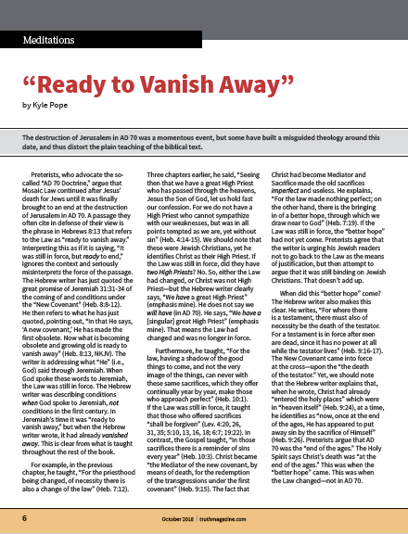
Kyle Pope, “Ready to Pass Away,” Truth Magazine 62.10 (Oct. 2018): 6-7

Slide 275
Answering Don. K. Preston
To prophesy that there would be something “new” from Jeremiah’s perspective would indicate that the “old” was “becoming obsolete,” “growing old” and “ready to vanish away.”

Slide 276
Answering Don. K. Preston
Preston mocked this argument, accused me of ignoring the tense of the verbs in the passage, and said it would be ridiculous to speak of the Law (at the time of Jeremiah) as “ready to vanish away.”

Slide 277
Answering Don. K. Preston
I urge Preston to rethink this in light of the use of mellō in Acts 26:22-23.
If the Holy Spirit can lead Paul to describe Jesus as “about to come” when Moses and the prophets wrote, He can lead the Hebrew writer to say that when Jeremiah wrote it was “ready to vanish away.”

Slide 278
Answering Don. K. Preston
The Book of Revelation

Slide 279
Answering Don. K. Preston
In the book, I devote an entire chapter to the date of the book of Revelation.
When Preston did the videos, he was in the middle of a written debate on this issue, so he only offered a few comments.

Slide 280
Answering Don. K. Preston
First, several times throughout the videos he appealed to Deuteronomy 32:43, from the Song of Moses, which reads:
“Rejoice, O Gentiles, with His people; For He will avenge the blood of His servants, and render vengeance to His adversaries; He will provide atonement for His land and His people.”

Slide 281
Answering Don. K. Preston
Preston argues, that this is a specific prophecy pointing to AD 70 and claims that Revelation 19:2 proves it.
In describing the fall of Babylon the Great, it reads: “For true and righteous are His judgments, because He has judged the great harlot who corrupted the earth with her fornication; and He has avenged on her the blood of His servants shed by her.”

Slide 282
Answering Don. K. Preston
His argument rests on the common phrase:
“Avenged . . . the blood of His servants.”
Throughout the videos, whenever I have made points appealing to similar wording, he charges me inaccurately with ITTF.
Why is it acceptable for him to do it here?

Slide 283
Answering Don. K. Preston
I have argued that the Song of Moses was a general warning to Israel throughout its history that established a common vocabulary of rebuke for the Jews (Deut. 31:19-21).
While Preston agrees that it functioned this way, he maintains his contention that it is a specific prophecy and fulfilment.

Slide 284
Answering Don. K. Preston
In another passage we can observe the same use of this language.
Punishment to the house of Ahab in the ninth century BC: “You shall strike down the house of Ahab your master, that I may avenge the blood of My servants the prophets, and the blood of all the servants of the LORD, at the hand of Jezebel” (2 Kings 9:7).

Slide 285
Answering Don. K. Preston
This echoes the wording of the Song of Moses just as closely if not closer than Revelation 19:2.
Is it a specific prophecy?

Slide 286
Answering Don. K. Preston
Why doesn’t Preston apply it that way in this passage?
If he did it wouldn’t support his false doctrine.

Slide 287
Answering Don. K. Preston
He made a few other very quick points.
He appeared to disagree with evidence I offered that Domitian, the emperor I believe was reigning when Revelation was written, insisted on being worshipped as a God.

Slide 288
Answering Don. K. Preston
If he is, he is disagreeing with ancient writers.
Both Suetonius and Dio Cassius claim that he did (Suetonius, Domitian 13.2; Cassius Dio, Roman History 67.4.7).

Slide 289
Answering Don. K. Preston
He criticizes me for offering evidence in the book that Rome, and not Jerusalem was known as a city set on seven hills (cf. Rev. 17:9).
He asserted that, “no preterists believe that this was Jerusalem!”

Slide 290
Answering Don. K. Preston
Well, Preston certainly knows more about full-preterism than I do, but he is wrong about this.
I have heard Full-preterists make this argument.

Slide 291
Answering Don. K. Preston
Preston makes much of Revelation 11:8:
“And their dead bodies will lie in the street of the great city which spiritually is called Sodom and Egypt, where also our Lord was crucified.”
Full-preterists contend that “Babylon the Great” (17:5; 18:2), whose downfall is promised in Revelation was Jerusalem, arguing that Revelation points to AD 70.

Slide 292
Answering Don. K. Preston
To support this, Preston appeals to the wording of this text “where also our Lord was crucified.”
Preston may assume that I equate “Babylon the Great” with this “great city,” but I do not.

Slide 293
Answering Don. K. Preston
The text says this city “spiritually is called Sodom and Egypt”—not Babylon.
Two cities are both called great in Revelation: Jerusalem and Babylon.

Slide 294
Answering Don. K. Preston
Preston must also assume the temple in Revelation 11:1-2 is a physical temple rather than the spiritual temple of God’s people (cf. Rev, 3:12).
That is an odd view for one whose doctrine would have us spiritualize virtually everything!

Slide 295
Answering Don. K. Preston
A similar example of this arbitrary interpretation of references to Jerusalem as physical or spiritual depending on whether it fits their doctrine is seen in their treatment of the last chapters of Zechariah.

Slide 296
Answering Don. K. Preston
Ignoring how the NT uses the language of these chapters, Full-preterists argue that miraculous spiritual gifts (while certainly limited in duration) would end at AD 70.

Slide 297
Answering Don. K. Preston
They then ignore that the last chapter of Zechariah describes God’s deliverance of the spiritual Jerusalem and interpret it as a description of AD 70.
Preston made this argument in video thirteen.

Slide 298
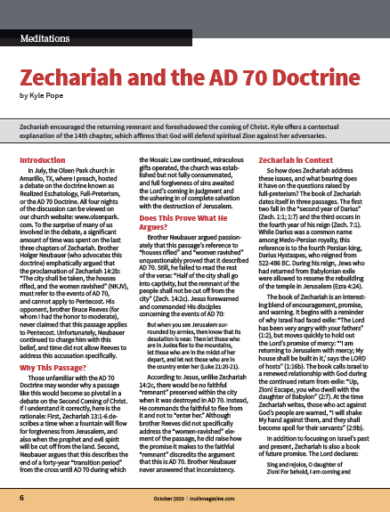
Kyle Pope, “Zechariah and the AD 70 Doctrine” Truth Magazine 64.10 (Oct. 2020): 6-7, 34

Slide 299
Answering Don. K. Preston
Ezekiel Appendix

Slide 300
Answering Don. K. Preston
I am honored that Preston felt that my material was worthy of devoting so much time to it.
But, I wish he had been more careful in his reading of it.
Example: He claimed that I had not documented my quotes from his material “not one time!” (video one).

Slide 301
Answering Don. K. Preston
On his Facebook and YouTube I gave page by page citation of where I had cited him.
To his credit, in video number two he apologized for the oversight.
Unfortunately, the problem didn’t stop.

Slide 302
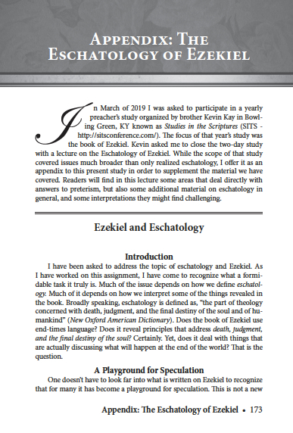
Several times he referred to a lecture I included in the appendix from a preacher’s study in which I had participated on eschatology in Ezekiel.

Slide 303
Answering Don. K. Preston
He made several assumptions that were the opposite of what was explicitly stated in the text.
1. He said I applied Ezekiel 32 to final judgment.
I did not! It describes positive and negative conditions in Sheol—I did not equate it with final judgement.

Slide 304
Answering Don. K. Preston
He made several assumptions that were the opposite of what was explicitly stated in the text.
2. Claimed I apply Ezekiel 37, the vision of the dry bones coming to life, to the final resurrection.
I did not!

Slide 305
Answering Don. K. Preston
He made several assumptions that were the opposite of what was explicitly stated in the text.
I wrote: “the resurrection of the dry bones vision . . . is not talking about ‘resurrection at the last day’ (John 11:24), but the spiritual resurrection after the Babylonian exile that would set the stage for the coming of Christ’s kingdom” (Thinking about AD 70, 195).

Slide 306
Answering Don. K. Preston
He made several assumptions that were the opposite of what was explicitly stated in the text.
In fact, in the chapter on resurrection, I include Ezekiel 37 in a section under the heading “Spiritual Resurrections” (ibid., 75).

Slide 307
Answering Don. K. Preston
Assuming that I teach things I do not, then building an argument against those false assumptions is not productive.

Slide 308
Answering Don. K. Preston
Fulfillment of the Law

Slide 309
Answering Don. K. Preston
In videos three, seven, and nine, while addressing points I discussed in the book about Christ’s fulfillment of the Law, Preston made more false claims about my views, then argued against things I have never taught!

Slide 310
Answering Don. K. Preston
In the book I was discussing Jesus’s words in Matthew 5:17: “Do not think that I came to destroy the Law or the Prophets. I did not come to destroy but to fulfill” (NKJV).

Slide 311
Answering Don. K. Preston
“At least two ways” this can be understood:
1. Jesus fulfilled what was spoken about Him;
2. Jesus “established” or empowered the Law to accomplish its purpose (Thinking about AD 70, 47-48).
“At least,” not an exhaustive list.

Slide 312
Answering Don. K. Preston
In the second point I addressed several principles addressed in Scripture, including atonement, redemption, salvation, and that Christ’s teachings “showed the way to fulfill the moral intent of the Law” (ibid.).

Slide 313
Answering Don. K. Preston
Preston ignored any other aspects of fulfillment I had offered and falsely claimed that I teach that “some moral fulfillment” or the “spirit of the OT” was all that Christ had to fulfill.
That is not true, as any careful reader of the text can see.

Slide 314
Answering Don. K. Preston
As I moved to the next verse in the book, Preston’s false claims about it continued.
“For assuredly, I say to you, till heaven and earth pass away, one jot or one tittle will by no means pass from the law till all is fulfilled” (Matt. 5:18).

Slide 315
Answering Don. K. Preston
Full Preterist Assumptions:
1. Many treat the words “heaven and earth” as a figurative reference to the Mosaic system.
For them the sense is the Mosaic system lasts until “all is fulfilled.”

Slide 316
Answering Don. K. Preston
Full Preterist Assumptions:
2. Assume it predicts when the law ends, rather than its reliable nature.
In the book I point out the parallel in Luke 16:17: “It is easier for heaven and earth to pass away than for one tittle of the law to fail.”

Slide 317
Answering Don. K. Preston
Full Preterist Assumptions:
3. Assume that there is no sense in which the phrase “the law” envisions the fulfillment and establishment of perfect law in the Law of Christ.

Slide 318
Answering Don. K. Preston
Preston, based on his own flawed assumptions, makes this false claim:
“According to Mr. Pope, the OT remains in place until the end of the material universe.”
That is ludicrous!

Slide 319
Answering Don. K. Preston
In virtually every video he disagreed with my understanding that the Law or Moses was “taken out of the way” and nailed “to the cross” (cf. Col. 2:14).
How can I believe the Law was “taken out of the way” but that it still “remains in place”?

Slide 320
Answering Don. K. Preston
Clearly, I cannot, and do not!
Perhaps he was trying to claim that would be a logical consequence of my views.
If so, that’s what he should have said.

Slide 321
Answering Don. K. Preston
Putting words in my mouth that I have never said doesn’t help anyone.

Slide 322
Answering Don. K. Preston
That is not a logical consequence of my beliefs because I believe the verse is emphasizing the enduring reliability of God’s word as revealed in the Law.

Slide 323
Answering Don. K. Preston
If it does include the sense that the Law of Christ fulfills and establishes the purpose of Mosaic Law it is not talking about a time when the law ends at all, but about the enduring reliability of the word.

Slide 324
Answering Don. K. Preston
Four Flawed Assumptions

Slide 325
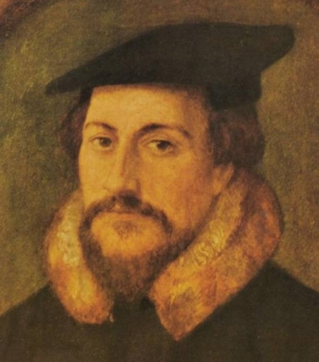
Since the time of the Protestant Reformation, the false doctrine of Calvinism has had a pervasive influence on the religious world.
John Calvin

Slide 326
Answering Don. K. Preston
How could a doctrine that teaches:
God (apart from any choices of man) arbitrarily chooses some to save and some to condemn
God is the direct cause of all things—even sin!
Christ only died for those God had already chosen to save

Slide 327
Answering Don. K. Preston
How could a doctrine that teaches:
Once one is part of the elect he or she can never sin in such a way as to be lost
How could such a doctrine ever gain any acceptance by students of Scripture?

Slide 328
Answering Don. K. Preston
If one grants the false premises that:
The sovereignty of God demands that He must be the cause of all things
Adam’s sin made all of his posterity sinful by nature and incapable of doing any good
Then logic leads one to accept all the false concepts built upon these flawed assumptions.

Slide 329
Answering Don. K. Preston
Realized Eschatology is quite similar to this.

Slide 330
Answering Don. K. Preston
If we grant the false premises that:
All apocalyptic language is figurative
All time statement must be narrowly interpreted
The book of Revelation was written before AD 70
The Mount of Olives Discourse only about AD 70

Slide 331
Answering Don. K. Preston
If we grant the false premises that:
Logic can lead a person to accept all of the skewed doctrines built upon these flawed premises.

Slide 332
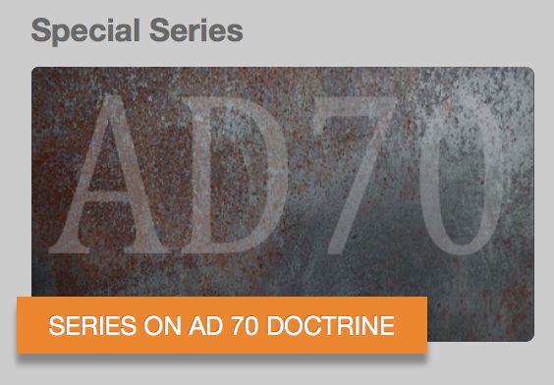
Kyle Pope, Olsen Park church of Christ
“The AD 70 Doctrine,” June 4, 17, 21, 24, 2020
https://olsenpark.com/SpecialStudies/AD70.html

Slide 334
Answering Don. K. Preston
If any of them fails, the entire system collapses.
In reality, all four of these flawed premises are false.

Slide 335
Answering Don. K. Preston
In embracing these flawed premises advocates of this doctrine have allowed themselves to embrace an entire system that reinterprets fundamental biblical doctrines and is gravely heretical.

Slide 336
Answering Don. K. Preston
I pray to God that they may open their eyes to this reality and turn from this error.

Slide 337
Answering Don. K. Preston
Conclusion

Slide 338
Answering Don. K. Preston
In his last video, Preston said having read my book he finds my reasoning:
“uncritical, illogical, and unbiblical.”
Since I believe Preston’s doctrine is wrong, if the AD 70 Doctrine is the standard of what is critical, logical, and biblical, I say, “Thank you!”

Slide 339
Answering Don. K. Preston
In the same video, he went on to say (once again) that as a “fifth generation member of churches of Christ”. . .
“Mr. Pope’s views stand outside the normal tradition of the amillennialism in the churches of Christ.”

Slide 340
Answering Don. K. Preston
I’m not sure how he said that with a straight face.
Full-preterism is about as far “outside the normal tradition” of churches of Christ as one can imagine!

Slide 341
Answering Don. K. Preston
I’m not sure why he would say that.
I believe that the Bible teaches Jesus will literally, visibly, and actually come again some time in the future, at which time there will be a literal bodily of all human souls who have ever lived followed by judgment and a destruction of the present universe.
That’s what most members of churches of Christ believe and teach.

Slide 342
Answering Don. K. Preston
I’m not sure why he would say that.
I do not believe Matthew 24:34 is a hard transition verse, but the entire discourse has elements aimed at preparation for AD 70 and final judgment.
Not all brethren would put it that way.

Slide 343
Answering Don. K. Preston
I’m not sure why he would say that.
I believe 2 Peter 3 speaks literally of heaven and earth.
Not all brethren would put it that way.

Slide 344
Answering Don. K. Preston
I’m not sure why he would say that.
I believe the book of Revelation was written near the end of the first century (well after AD 70).
Most brethren would agree.

Slide 345
Answering Don. K. Preston
I’m not sure why he would say that.
In the appendix, I offer an argument that the “four living creatures” of Ezekiel and Revelation is a figurative and spiritual way of describing the people of God worshipping God.
Most brethren are unfamiliar with this argument, but it is not in conflict with any doctrine taught over the years.

Slide 346
Answering Don. K. Preston
What is in conflict with what churches of Christ have taught is the AD 70 Doctrine that Preston promotes.

Slide 347
Answering Don. K. Preston
Brother Preston, this is not about me.
It is not about you.
It is about truth.

Slide 348
Answering Don. K. Preston
One day, you and I will both stand before God and be judged by what we believe and teach.
If your background is rooted in churches of Christ, I presume that you were baptized into Christ for the remission of sins.
If so, that makes you my brother in Christ.

Slide 349
Answering Don. K. Preston
Unfortunately, your teaching demonstrates that you do not abide “in the doctrine of Christ” (2 John 9).
It is “disorderly” and not in keeping with apostolic tradition (2 Thess. 3:6).
You are not my “enemy,” but I humbly and sincerely admonish you “as a brother” (2 Thess. 3:15).

Slide 350
Answering Don. K. Preston
I know you have come to believe that you have unlocked some secret understanding of Scripture that has alluded others.
But I honestly believe it is deeply flawed and contrary to the teaching of the gospel.

Slide 351
Answering Don. K. Preston
I beg you (and any who have adopted the false doctrines you embrace) to reconsider your conclusions, repent, and turn to sound doctrine.

Slide 352
Answering Don. K. Preston
When any doctrine leads one to adopt concepts about atonement, the honesty of God, the nature of God, the sinlessness of Christ, the efficacy of the cross, and the meaning of clear teaching in Scripture that doctrine is wrong.

Slide 353
Answering
Don K. Preston
February 2022

