Slide 1
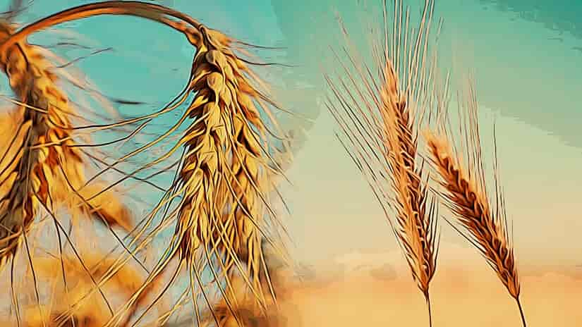
The Parable of the Wheat and the Tares
Matthew 13:24-30

Slide 2
Explanation of the Parable Matthew 13:36-43
Good seed is sown by the Son of Man.
The field is the world.
The good seeds are the sons of the kingdom.
The tares are the sons of the wicked one.
The enemy is the devil.
The harvest is the end of the age.
The reapers are the angels.

Slide 3
Lessons from the Parable
Jesus has brought the “good seed” of the gospel (Luke 4:18-21)
God is not the cause of evil (Jas. 1:13-15; John 8:42-44).
The kingdom exists in a world of evil (1 John 5:18-20; Phil. 2:14-16).

Slide 4
Lessons from the Parable
Separation will come in the end (Mat 13:47-50; 25:31-32).
God allows this to prevent souls from being lost (2 Pet. 3:9).
Punishment will come to the the “sons of the wicked one” (1 John 3:7-9; John 15:5-8).

