Slide 1
John 18:33-37
“Then Pilate entered the Praetorium again, called Jesus, and said to Him, ‘Are You the King of the Jews?’ 34 Jesus answered him, ‘Are you speaking for yourself about this, or did others tell you this concerning Me?’ Pilate answered, ‘Am I a Jew? Your own nation and the chief priests have delivered You to me. What have You done?’ Jesus answered, ‘My kingdom is not of this world...”

Slide 2
John 18:33-37
“…If My kingdom were of this world, My servants would fight, so that I should not be delivered to the Jews; but now My kingdom is not from here.’ Pilate therefore said to Him, ‘Are You a king then?’ Jesus answered, ‘You say rightly that I am a king. For this cause I was born, and for this cause I have come into the world, that I should bear witness to the truth. Everyone who is of the truth hears My voice’” (NKJV).

Slide 3
Deuteronomy 17:14-20
“When you come to the land which the LORD your God is giving you, and possess it and dwell in it, and say, ‘I will set a king over me like all the nations that are around me,’ you shall surely set a king over you whom the LORD your God chooses; one from among your brethren you shall set as king over you; you may not set a foreigner over you, who is not your brother. But he shall not multiply horses for himself…”

Slide 4
Deuteronomy 17:14-20
“…nor cause the people to return to Egypt to multiply horses, for the LORD has said to you, ‘You shall not return that way again.’ Neither shall he multiply wives for himself, lest his heart turn away; nor shall he greatly multiply silver and gold for himself. Also it shall be, when he sits on the throne of his kingdom, that he shall write for himself a copy of this law in a book, from the one before the priests, the Levites...”

Slide 5
Deuteronomy 17:14-20
“…And it shall be with him, and he shall read it all the days of his life, that he may learn to fear the LORD his God and be careful to observe all the words of this law and these statutes, that his heart may not be lifted above his brethren, that he may not turn aside from the commandment to the right hand or to the left, and that he may prolong his days in his kingdom, he and his children in the midst of Israel” (NKJV).

Slide 6
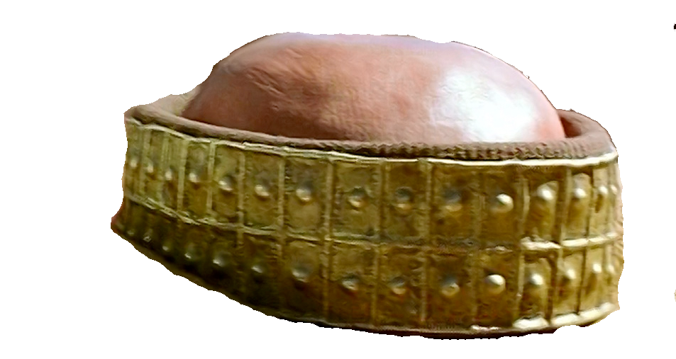
A Different
Kind of King
I. Who Could Be King?
One chosen by God (17:15a).
One of their brethren (17:15b).
Jesus was God’s chosen (Matt. 12:14-21).
Jesus was an Israelite (Matt. 1:1-17).

Slide 7
A Different
Kind of King
II. What Would Be His Strength?
Not military might (i.e. horses) (17:16).
Not political alliances (i.e. wives) (17:17).
Jesus was not a military conqueror (Matt. 21:1-9).
He was not interested in worldly political power (Luke 22:25-27).

Slide 8
A Different
Kind of King
III. What Would Guide Him?
God’s Law (17:18-19).
This would Prolong His Kingdom (17:20).
Jesus always did God’s will (John 8:28-29).
His kingdom will stand forever (Dan. 2:44).

