Slide 1
Deuteronomy 34:1-5
“Then Moses went up from the plains of Moab to Mount Nebo, to the top of Pisgah, which is across from Jericho. And the LORD showed him all the land of Gilead as far as Dan, all Naphtali and the land of Ephraim and Manasseh, all the land of Judah as far as the Western Sea, the South, and the plain of the Valley of Jericho, the city of palm trees, as far as Zoar…”

Slide 2
Deuteronomy 34:1-5
“…Then the LORD said to him, “This is the land of which I swore to give Abraham, Isaac, and Jacob, saying, ‘I will give it to your descendants.’ I have caused you to see it with your eyes, but you shall not cross over there. So Moses the servant of the LORD died there in the land of Moab, according to the word of the LORD” (NKJV).

Slide 3
Things Moses Saw From Mount Pisgah
View of Jordan River Valley from Mt. Nebo
The End Does Not Justify the Means (Rom. 3:8).

Slide 4
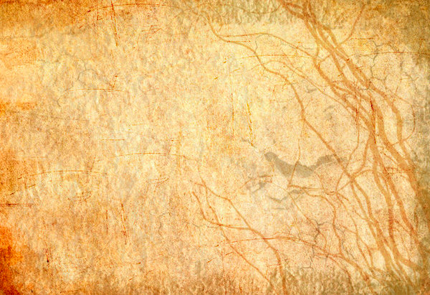
The End Does Not Justify the Means
Water from Rock—Strike the rock (Exodus 17:1-7).
Water from Rock—Speak to the rock (Numbers 20:1-11).
Consequence: Numbers 20:12

Slide 5
Things Moses Saw From Mount Pisgah
View of Jordan River Valley from Mt. Nebo
Our Sins Will Always Find Us Out (Num. 32:23).

Slide 6
Our Sins Will Always Find Us Out
Achan’s sin was discovered (Josh. 7:20-25).
David’s sin with Bathsheba was discovered (2 Sam. 12:7-12).
No one can hide from God (Heb. 4:12-13).
We must not take God’s patience for granted (2 Pet. 3:9-12).

Slide 7
Things Moses Saw From Mount Pisgah
View of Jordan River Valley from Mt. Nebo
Sin, Though Committed With The Best of Intentions, Is Still Sin! (Prov. 14:12)

Slide 8
Sin Is Still Sin!
It was sin for Uzzah to steady the ark of the covenant (2 Sam. 6:6-7).
It was sin for Saul to sacrifice from the blunder of Amelek (1 Sam. 15:21-22).
We may be condemned by things we approve (Rom. 14:22-23).

Slide 9
Things Moses Saw From Mount Pisgah
View of Jordan River Valley from Mt. Nebo
The Wages of Sin Are Certain (Heb. 2:1-3).

Slide 10
The Wages of Sin Are Certain
The soul who sins shall die (Ezek. 18:20).
The wages of sin is death (Rom. 6:23).
We will receive judgment for what we do in the flesh (2 Cor. 5:9-11).

Slide 11
Things Moses Saw From Mount Pisgah
View of Jordan River Valley from Mt. Nebo
Others May Influence Us To Sin, But We Are Held Accountable For Our Own Actions (2 Cor. 5:10).

Slide 12
We Are Accountable for Our Own Actions
Eve influenced Adam, but he was held accountable for his sin (Gen. 3:17-19).
Jonadab influenced Amnon, but he was held accountable for his sin (2 Sam. 13:1-15).
The blind leading the blind, both fall in a ditch (Matt. 15:13-14).

