Slide 1
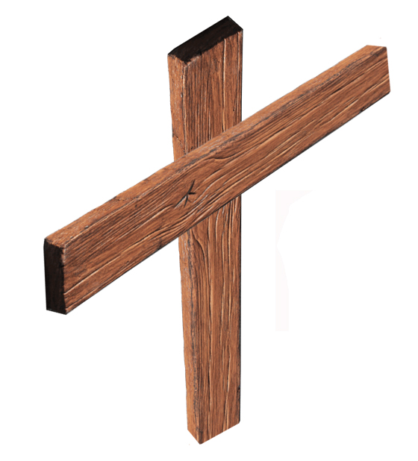
Prophecy and Establishment
OF
Old Testament
Gospels
Pentecost
THE CHURCH
Isaiah 2:2-3
Establish Lord’s House
Law from Jerusalem
Q
Daniel 2:44
“Days of these kings”
Everlasting Kingdom
Q
Joel 2:28-32
Pour out Spirit
Salvation—Call on Lord
Q
Jeremiah 31:31-32
New Covenant
Forgiveness of Sins
Matthew 3:1-3; 4:17
Kingdom “at hand”
Q
John 3:1-6
“Enter” the kingdom
Q
Matthew 16:18-19
Build “My church”
Kingdom = church
Q
Mark 9:1
Kingdom with power
“This generation”
Q
Mark 15:16-20; 16
Crucified—Resurrected
Acts 1:3
Spoke about kingdom
Q
Acts 1:4-8
Stay in Jerusalem
Spirit’s coming—power
Q
Acts 2:1-4
Apostles receive Spirit
Q
Acts 2:16
Prophecy of Joel
Q
Acts 2:36-47; 5:11
Salvation—Forgiveness
Added to church
THE CROSS

