Slide 1
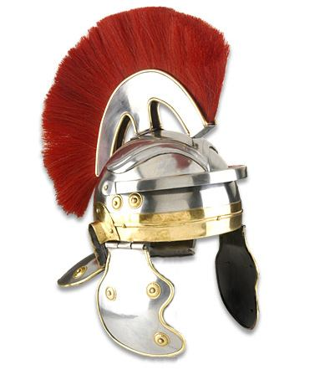
The Healing of the Centurion’s Servant
Matthew 8:5-13

Slide 2
The Healing of the Centurion’s Servant
“Now when Jesus had entered
Capernaum, a centurion came to
Him, pleading with Him” (Matt.8:5).
Centurion – lit. “an archos of one hundred.”
“…Representatives of Roman law and order and were men of force of character” (A. T. Robertson, Commentary, 121).
Built their synagogue, loved their nation (Luke 7:5).

Slide 3
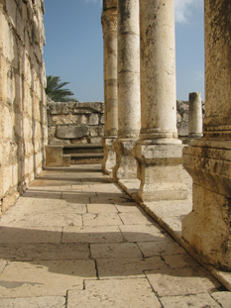
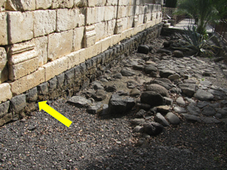
The Healing of the Centurion’s Servant
“Now when Jesus had entered
Capernaum, a centurion came to
Him, pleading with Him” (Matt.8:5).
Basalt foundation of an older ancient synagogue in Capernaum
Ancient synagogue in Capernaum

Slide 4
The Healing of the Centurion’s Servant
“Now when Jesus had entered
Capernaum, a centurion came to
Him, pleading with Him” (Matt.8:5).
The elders came to Jesus and, “begged Him earnestly, saying that the one for whom He should do this was deserving” (Luke 7:4b-5).
At this word Jesus went with them (Luke 7:6)..
Given by inspiration of the Holy Spirit (2 Tim. 3:16).

Slide 5
The Healing of the Centurion’s Servant
“Lord, my servant is lying at
Home paralyzed, dreadfully
tormented” (Matt.8:6).
Matthew: “servant” (pais) – child or servant.
Luke: “servant” (doulos) – not applied to a child (7:2).
The servant was “dear to him” (Luke 7:2).
English word paralytic is from Greek word used here.
Paralyzed & “suffering great pain” (NASB)

Slide 6
The Healing of the Centurion’s Servant
“I will come and heal him”
(Matt.8:7).
After the Jewish elders relayed the message, Jesus “went with them” (Luke 7:6a).

Slide 7
The Healing of the Centurion’s Servant
“The centurion answered and said
‘Lord, I am not worthy that You should
come under my roof. But only speak a word, and my servant will be healed’” (Matt.8:8).
“When he was already not far from the house, the centurion sent friends to him” (Luke 7:6b).
He calls a simple Jewish carpenter’s son – “Lord.”
“I did not even consider myself worthy to come to you” (Luke 7:7).

Slide 8
The Healing of the Centurion’s Servant
“The centurion answered and said
‘Lord, I am not worthy that You should
come under my roof. But only speak a word, and my servant will be healed’” (Matt.8:8).
“Only speak a word” – faith and respect for authority.
Did he expect Jesus’ disciples to carry out the healing?
Did he understand that Jesus’ authority extends beyond the material world?
Jesus was worthy of respect, with greater authority than his own.

Slide 9
The Healing of the Centurion’s Servant
“The centurion answered and said
‘Lord, I am not worthy that You should
come under my roof. But only speak a word, and my servant will be healed’” (Matt.8:8).
We need souls with this attitude today!
That power to “only speak a word” still resides in His revealed word, the Bible.
We “are not worthy” to go beyond it.
We must respect the authority that rests in His word.

Slide 10
The Healing of the Centurion’s Servant
“For I also am a man under
authority, having soldiers under me.
And I say to this one, ‘Go,’ and he goes; and to another, ‘Come,’ and he comes; and to my servant, ‘Do this,’ and he does it” (Matt.8:9).
“Seeing Jesus near his house and having already sent the second delegation, the centurion came personally to meet Jesus and restates the problem in more detail”
Jack Russell Shaffer, “A Harmonization of Matthew 8:5-13 and Luke 7:1-10” 48.

Slide 11
The Healing of the Centurion’s Servant
“For I also am a man under
authority, having soldiers under me.
And I say to this one, ‘Go,’ and he goes; and to another, ‘Come,’ and he comes; and to my servant, ‘Do this,’ and he does it” (Matt.8:9).
“A man under authority” (8:9).
“The centurion reasoned inductively that they were both under authority. He understood that only those who can take orders are allowed to give orders”
Kenneth Chumbley, Commentary on Matthew, 153.

Slide 12
The Healing of the Centurion’s Servant
“For I also am a man under
authority, having soldiers under me.
And I say to this one, ‘Go,’ and he goes; and to another, ‘Come,’ and he comes; and to my servant, ‘Do this,’ and he does it” (Matt.8:9).
Today Christians are “under Christ’s authority.”
To go beyond His word is to reject His authority.
To respect His word is not “legalism.”
It is a gesture of humble obedience and faith in the One who authored that word.

Slide 13
The Healing of the Centurion’s Servant
Jesus praised the man’s faith,
and foreshadowed the Gentiles’
inclusion in the gospel (Matt.8:10-12).
What happened to the servant?
“Go your way; and as you have believed, so let it be done for you” (8:13a).
“His servant was healed that same hour” (8:13b).

Slide 14
The Healing of the Centurion’s Servant
Jesus praised the man’s faith,
and foreshadowed the Gentiles’
inclusion in the gospel (Matt.8:10-12).
“That same hour”—“is for the Gospels a phrase unique to Matthew (8:13; 9:22; 15:28; 17:18)” Jack P. Lewis, Commentary on Matthew 1.123.
“Those who were sent, returning to the house, found the servant well who had been sick” (Luke 7:10).

Slide 15
The Healing of the Centurion’s Servant
If this Roman centurion showed such great faith in and respect for the word of Jesus…
…should we show any less?

