Slide 1
Can I Forgive God?

Slide 2
God never does wrong!
1

Slide 3
1. Sin by its very definition is the violation of God’s law (1 John 3:4).
2. It is God who defines what’s right and what’s wrong.
3. In an absolute sense there is never anything God can do for which He needs our forgiveness.

Slide 4
“His work is perfect; for all His ways are justice, a God of truth and without injustice; righteous and upright is He.”
Deuteronomy 32:4

Slide 5
“Far be it from God to do wickedness, and from the Almighty to commit iniquity.”
Job 34:10

Slide 6
Man cannot always understand all of God’s ways.
2

Slide 7
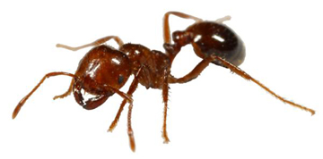
1. An ant cannot understand a man!
2. God is infinitely greater than a man in comparison to an ant.
3. We can understand what He demands of us (Eph. 5:17), but we may never understand why.

Slide 8
“Oh, the depth of the riches both of the wisdom and knowledge of God! How unsearchable are His judgments and His ways past finding out!”
Romans 11:33

Slide 9
Our Misunderstanding of God may cause us to charge Him with wrong.
3

Slide 10
1. “Job did not sin nor charge God with wrong” (Job 1:22).
• We aren’t all that strong.
• We want to understand.
• We want to make sense of it all.
2. When it doesn’t seem to make sense, the unanswered questions lead us to blame God.

Slide 11
“As you do not know what is the way of the wind, or how the bones grow in the womb of her who is with child, so you do not know the works of God who makes everything.”
Ecclesiastes 11:5

Slide 12
What Are We to Do With This?

Slide 13
Harbor resentment against God.
1

Slide 14
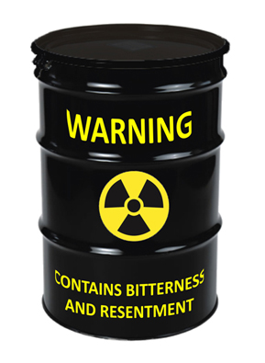
1. Many people live their lives with great bitterness towards God.
• “WHY!”
• “I’ll never serve a God like that!”
2. Resentment resolves nothing!
• Resentment of God doesn’t change our accountability to God.

Slide 15
“It is appointed for men to die once, but after this the judgment.”
Hebrews 9:27

Slide 16
“We must all appear before the judgment seat of Christ, that each one may receive the things done in the body, according to what he has done, whether good or bad.”
2 Corinthians 5:10

Slide 17
3. Resentment demands great energy!
• You must constantly remind yourself what one has done that caused the resentment.
• You must guard your actions lest you accidentally fail to treat that person with the distance and distain that resentment demands.

Slide 18
Try to avoid God.
2

Slide 19
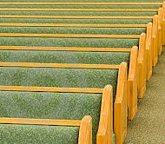
Empty pews and missed Bible studies don’t always come from an intellectual rejection of the truth of the gospel.
2. We imagine that if we do not expose ourselves to reminders of who God is it changes our need to answer to Him.

Slide 20
“Where can I go from Your Spirit? Or where can I flee from Your presence?”
Psalm 139:7

Slide 21
Choose to trust God.
3

Slide 22
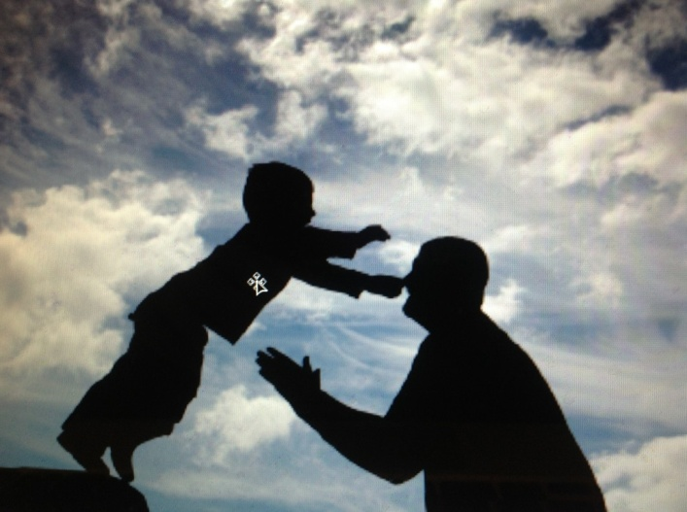
What Does it Mean to Trust God?
• Trust is a confidence that even when we don’t understand we assure ourselves that His commands are “for our good always” (Deut. 6:4).
• Christians recognize that this life is “full of trouble” (Job 14:1).

Slide 23
What Does it Mean to Trust God?
• Trust is choosing to believe, even when it’s hard to see how, that “all things work together for good to those who love God” (Rom. 8:28).
• Does that mean we always smile—we never struggle?

Slide 24
“Though He slay me, yet will I trust Him.”
Job 13:15
The example of JOB

Slide 25
God Did Not “Slay” Job Satan was behind it all (Job 1:12; 2:7), using the sinful choices of the Sabeans (Job 1:15) and the Chaldeans (Job 1:17), together with his own manipulation of natural laws (1:16, 18; 2:7).

Slide 26
“The fire of God fell from heaven and burned up the sheep and the servants.”
Job 1:16
The example of JOB

Slide 27
“All that he has is in your power.”
Job 1:12
The example of JOB

Slide 28
• It was Satan who slew Job!
• We must never confuse God’s allowance of something with His direct action.
• Even though Job didn’t distinguish God’s allowance from His direct action he didn’t let the sins of others compromise His trust in God!
• Job understood that “God is faithful” (1 Cor. 1:9; 10:13; 2 Cor. 1;18).

Slide 29
Choose to forgive God.
4

Slide 30
1. The Bible uses a number of different terms that we translate with the English word “forgive.”
2. They can apply to forgiveness of violations of Divine Law, but also things that do not involve sin.
3. One party releases another party from something held over them.

Slide 31
“On me, my lord, on me let this iniquity be!”
1 Samuel 25:24
The example of Abigail

Slide 32
“Please forgive the trespass of your maidservant.”
1 Samuel 25:28
The example of Abigail

Slide 33
FORGIVE
Hebrew Old Testament
nasa’ (ac;n:)
“to lift, bear up, carry, take” (BDB).

Slide 34
She had done nothing wrong but she called upon David, to bear the insult of her husband (which she sought to take upon herself).
She asked him to just “take it” without revenge.

Slide 35
FORGIVE
Greek New Testament
aphiemi (ἀϕίημι)
“to send away” (Thayer).

Slide 36
1. The parable of the unmerciful servant, the king “made him free of the debt” (Matt. 18:27, BBE).
2. Positively: the apostles “left all” to follow Jesus (Mark 10:28); fever left the nobleman’s son when Jesus healed him (John 4:52).
3. Negatively: The Pharisees “laying aside” the commandments of God (Mark 7:8) or Ephesians “left” their “first love” (Rev. 2:4).

Slide 37
“The prayer of faith will save the sick, and the Lord will raise him up. And if he has committed sins, he will be forgiven (ἀϕίημι).”
James 5:15

Slide 38
“If we confess our sins, He is faithful and just to forgive (ἀϕίημι) us our sins and to cleanse us from all unrighteousness.”
1 John 1:9
HE DISMISSES THEM—Sends them Away!

Slide 39
“Forgive us our debts, as we forgive our debtors.”
Matthew 6:12
We must Let it go!

Slide 40
Can We Forgive God?

Slide 41
I am not saying that God has ever truly wronged us.
I am talking about our own difficulty to understand things about God that trouble us.
The best choice is to let it go— this is forgiveness.

Slide 42
FORGIVE
“Stop feeling angry or resentful toward (someone) for an offense, flaw, or mistake” (New Oxford American Dictionary)

Slide 43
If we don’t understand something about God, we need to “stop feeling angry or resentful toward” Him and choose not to hold our misunderstanding against Him.

Slide 44
If we hope that God will “send away” our sins, we must be willing to trust that (even if we don’t understand it) God has never wronged us.
We can choose to bear the uncertainty.
We can decide to let it go.
We can choose to dismiss our resentment.

Slide 45
Can I Forgive God?

