Slide 1
Israel’s Errors
God tells us about Israel’s errors
1 Cor. 10:1-12
Lessons as a group
Lessons from individuals

Slide 2
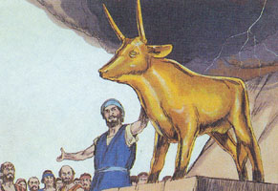
Aaron’s Error
Aaron’s biography
Moses’ brother chosen by God (Ex. 4).
Labored in Egypt (Ex. 5).
First high priest (Ex. 28).
Man of faith & failure (Num. 12; Lev. 10; Num. 20).

Slide 3
Aaron’s Error
Desire for Approval
Failure to Lead
No Respect for Authority

Slide 4
Aaron’s Error
I. Desire for Approval.
Wanted to please people (Ex. 32:1-6).
We want to be approved by others
Family – Friends
Co-workers – Neighbors
Brethren

Slide 5
Aaron’s Error
I. Desire for Approval.
We are to live in peace (Rom. 12:18).
But we must not compromise (Exod. 23:2; Matt. 10:34-39; Luke 6:26).

Slide 6
Aaron’s Error
II. Failure to Lead.
Aaron was supposed to lead, not follow.
We must stand for what is right.
Preachers (2 Tim. 4:2-5).
Elders (Titus 1:9-11).
Husbands/Fathers (Eph. 5:22-24).

Slide 7
Aaron’s Error
III. No Respect for Authority.
God condemned idolatry (Exod. 20:2-6).
Aaron ignored this (Exod. 32:1-6).
God’s command had not changed.
Aaron followed the will of man.

Slide 8
Aaron’s Error
III. No Respect for Authority.
Authority must come from God (Num. 12; Exod. 20:2-6).
Heaven or men? (Matt. 21:23-27).
Acceptable authority (Col. 3:17; Matt. 17:5).

Slide 9
Aaron’s Error
III. No Respect for Authority.
The Gospel has not changed (Jude 3).
Morality (1 Cor. 6:9-10).
Church (Eph. 1:22-23; Heb. 10:24-25).
Salvation (Rom. 10:9-10; Acts 2:38).

