Slide 1
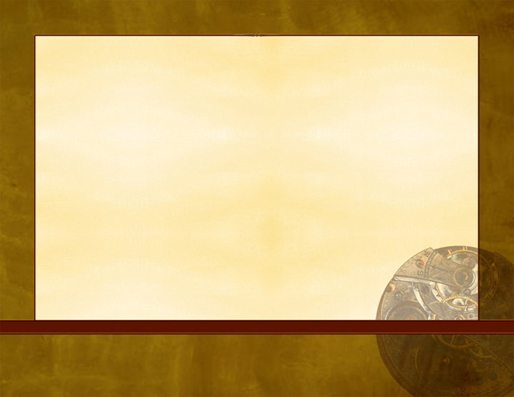
Hebrews 11:24-27
“By faith Moses, when he became of age, refused to be called the son of Pharaoh’s daughter, choosing rather to suffer affliction with the people of God than to enjoy the passing pleasures of sin, esteeming the reproach of Christ greater riches than the treasures in Egypt; for he looked to the reward. By faith he forsook Egypt, not fearing the wrath of the king; for he endured as seeing Him who is invisible” (NKJV).

Slide 2
Moses In the Book of Hebrews
I. Rejected Earthly Glory
“Refused to be called the son of Pharaoh’s daughter” (vs. 24).
Many love earthly glory (John 12:42-43).
The apostles rejected earthly glory (1 Thess. 2:4-6).

Slide 3
Moses In the Book of Hebrews
II. Made A Wise Choice
“Choosing rather to suffer affliction with the people of God” (vs. 25a).
Man must choose for himself whom he will serve (Josh. 24:15).
We must choose good (Isa. 7:14-15).
Some choose evil (Acts 13:46).

Slide 4
Moses In the Book of Hebrews
III. Correct Appraisal of Things
“Esteeming the reproach of Christ greater riches than the treasures in Egypt” (vs. 26a).
Valuing treasure in heaven (Matt. 6:19-20).
Pursing spiritual riches (Matt. 13:45-46).
Valuing the wrong things can make one to stray from faith (1 Tim. 6:9-10).

Slide 5
Moses In the Book of Hebrews
IV. He Lived a Separate Life
“By faith he forsook Egypt” (vs. 27a).
Christians must be separate from the world (2 Cor. 6:17-18).
Christians must be separate from all sin (1 Thess. 5:22).
This is resisting Satan (James 4:7-8).

Slide 6
Moses In the Book of Hebrews
V. Feared God, Not Man
“Not fearing the wrath of the king” (vs. 27b).
The apostles’ courage (Acts 4:19-20; 5:29).
Christians must be know whom to fear (Matt. 10:24-28).

Slide 7
Moses In the Book of Hebrews
VI. He Persevered
“For he endured” (vs. 27c).
Salvation comes to the one who endures (Matt. 10:21-22).
Endurance is not in vain (1 Cor. 15:58).
It results in the crown of life (James 1:12; Rev. 2:10).

Slide 8
Moses In the Book of Hebrews
VII. He Saw the Unseen
“As seeing Him who is invisible” (vs. 27d).
In Jesus we can see the invisible God (Col. 1:13-16).
The unseen things are eternal (2 Cor. 4:17-5:2).

