Slide 1
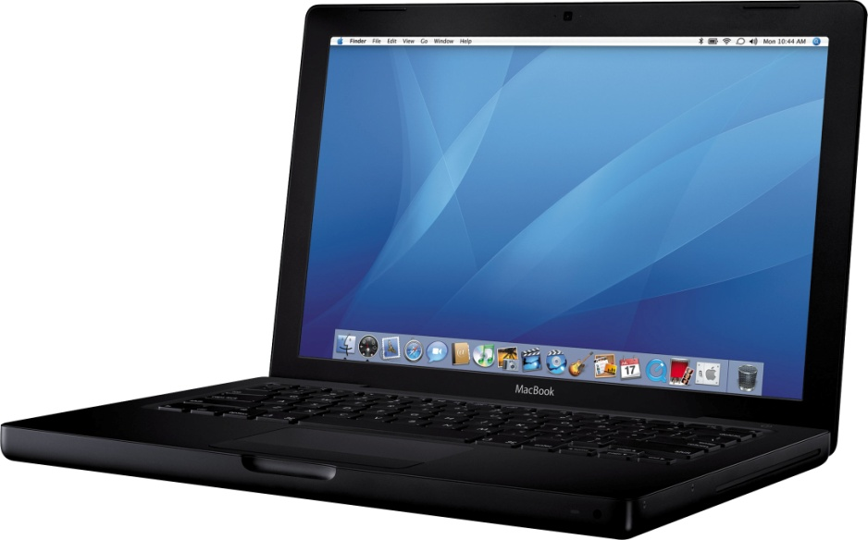
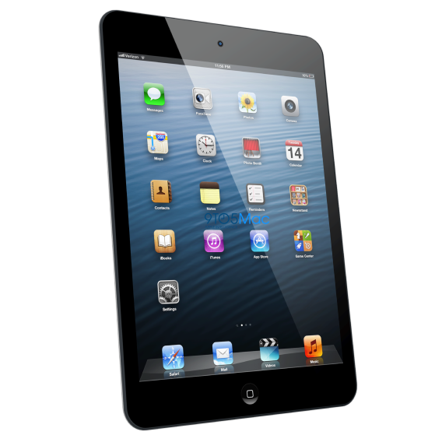
The Christian & Technology
Technology Presents Some…
I. Great Opportunities.
A. For Study and Teaching (2 Tim. 4:2; 1 Pet. 3:15-16).
B. For Encouragement and Contact (Rom. 12:15-16; Phil 2:4).
C. For Positive Influence (Rom. 12:9; (Matt. 5:14-16; Phil. 2:14-15).
D. For Time Saving (Eph. 5:15-17).

Slide 2
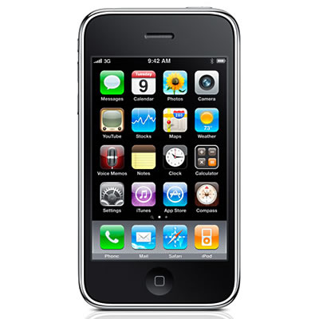
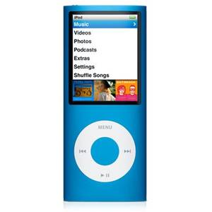
The Christian & Technology
Technology Presents Some…
II. Great Dangers.
A. Time it consumes (Rom. 13:11-12).
B. Influences it presents (1 Cor. 15:33-34; 2 Cor. 6:14-18).
C. Actions it motivates (Col. 3:22-24; 2 Cor. 8:21).
D. Attitudes it fosters (Heb. 13:5-6).

