Slide 1
DEPRESSION
“Major Depression” More than half of the days considered in the study they felt at least five of the following: 1) "little interest or pleasure in doing things" or 2) "feeling down, depressed, or hopeless". The other criteria are: 3) "trouble falling asleep or staying asleep or sleeping too much," 4) "feeling tired or having little energy," 5) "poor appetite or overeating," 6) feeling bad about yourself or that you were a failure or let yourself or your family down," 7) "trouble concentrating on things, such as reading the newspaper or watching television," and 8) "moving or speaking so slowly that other people could have noticed…or the opposite: being so fidgety or restless that you were moving around a lot more than usual."
“Other Depression” – If they met two, three, or four of the eight criteria for major depression, including at least 1 of the following 1) "little interest or pleasure in doing things" or 2) "feeling down, depressed, or hopeless."
Centers for Disease Control and Prevention
2010 Study of 235,000 people.
4%
Suffer from “Major Depression”
5%
Suffer from “Other Depression”
9%
Suffer from “Any Depression”

Slide 2
DEPRESSION
Centers for Disease Control and Prevention
2010 Study of 235,000 people.
Age
Largest numbers:
18-24
45-64
Marital Status
Previously married and single more than married
Gender
Women more than men

Slide 3
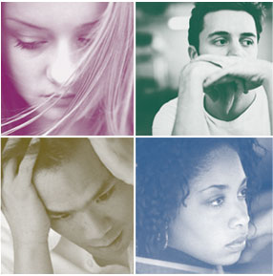
DEPRESSION
The Word “Depression.”
Most translations do not use the word “depressed” or “depression.”
In English history it has usually been used literally of something brought down.
* The modern sense is drawn from the idea of one whose spirits are brought down—”depressed.”

Slide 4
DEPRESSION
The Word “Depression.”
In New King James Version it is only used in Proverbs 12:25.
Heb. shachah Lit. “prostrate” KJV “to stoop.”
What we consider depression is usually not the result but the cause—”anxiety in the heart” KJV “heaviness in the heart.”

Slide 5
DEPRESSION
The Word “Depression.”
The Bible speaks often of heaviness of heart.
Job—loss and physical distress (Job 9:27).
David—mistreatment (Psalm 69:18-21).
Paul—the condition of others (Rom. 9:1-5).
Peter—trials (1 Pet. 1:6-8).

Slide 6
DEPRESSION
What Causes Depression?
Life isn’t what it should be.
* Disappoint-ments
* Health
Sadness and Loss
Our Own Sin
People have hurt us.

Slide 7
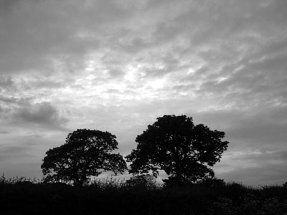
DEPRESSION
Biblical Solutions.
Meditation on God’s word (Psa. 119:25-28).
Pray and cultivate gratitude (Phil. 4:6-7).
Don’t let emotion control you (Prov. 16:32).

Slide 8
DEPRESSION
Biblical Solutions.
“A good word” (Prov. 12:25).
Seek sources of encouragement and be a source to others.
Refresh others (1 Cor. 16:17-18).

Slide 9
DEPRESSION
Biblical Solutions.
Repentance (2 Cor. 7:8-11).
Focus on heaven (Phil. 3:12-14).

