Slide 1
Saul’s War with Amalek (1 Sam. 15:1-23).
I. Saul Commanded to Destroy the Amalekites.
A. Samuel instructs Saul (1 Sam. 15:1-5).
B. Saul spares Agag and some livestock (15:7-9).
C. God is displeased (15:10-11).
D. Samuel rebukes Saul (15:13-15).
E. Saul’s rationalization (15:19-21).
F. “To obey is better than sacrifice” (15:22-23).

Slide 2
“To Obey is Better Than Sacrifice”
II. Who Were the Amalekites?
A. Amalek was a descendant of Esau (Gen. 36:16).
B. They harassed the Israelites in the Exodus (Exod. 17:8-13).

Slide 3
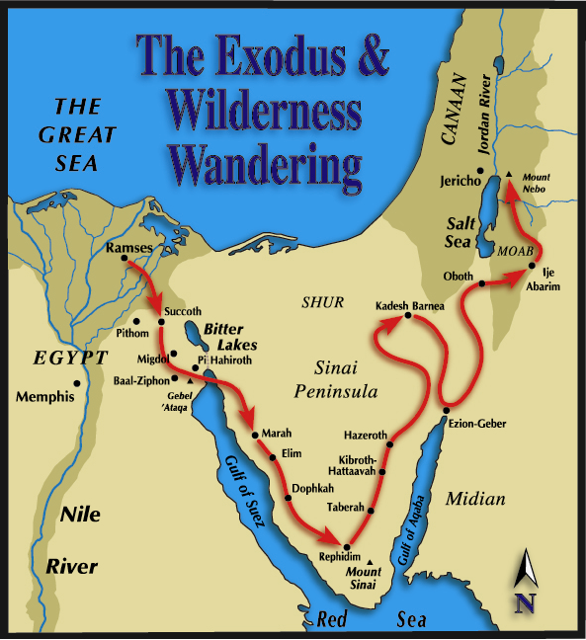

Slide 4
“To Obey is Better Than Sacrifice”
II. Who Were the Amalekites?
A. Amalek was a descendant of Esau (Gen. 36:16).
B. They harassed the Israelites in the Exodus (Exod. 17:8-13).
C. Mosaic Law demanded their destruction (Deut. 25:17-19).
Why would God destroy a nation? (Deut. 9:4-5).
“What the Lord hates, they do” (Deut. 12:29-32).

Slide 5
“To Obey is Better Than Sacrifice”
III. Mosaic Law Demanded Obedience.
A. “Be careful to observe” (Deut. 12:32).
B. Do not turn to right or left (Deut. 5:31-33).
C. Examples of this principle at work.
1. Sabbath regulations Exod (Exod. 35:2-3; Num. 15:32-36).
2. The ark of the covenant (Num. 1:50-54; 1 Sam, 6:1-7).

Slide 6
“To Obey is Better Than Sacrifice”
IV. Is Obedience Demanded in Christ?
A. “Obey the truth” (Rom. 2:8; 1 Pet. 1:22).
B. “Author of eternal salvation to all those who obey Him” (Heb. 5:9).
C. Not all who say “Lord, Lord” (Mt. 7:21-23).
D. “If anyone keeps my word” (John 8:51).
E. “If you keep my commandments” (John 15:9-14).

Slide 7
“To Obey is Better Than Sacrifice”
V. God has always Demanded Obedience.
A. Abraham (Gen. 22; Heb. 11:8-10; 17-19).
B. Noah (Heb. 11:7; Gen. 6:22).
C. Jesus (Heb. 5:8-9).

